Slide 1
complicanze in EUS
Elisabetta Buscarini
UOC Gastroenterologia ed Endoscopia Digestiva
Crema

Slide 2
Lecture plan
Background
Complications to non-interventional EUS
Complications to EUS-guided biopsy
Complications to EUS-guided treatments
Risk factors for complications
Specific complications: prevention and management

Slide 3
Background
EUS : accurate modality for locoregional staging of esophageal, gastric, rectal, and pancreatic cancers
EUS-guided interventional procedures, either diagnostic (biopsy) or therapeutic
Because of the nature of this procedure and the equipment required, EUS and its interventional applications would be expected to be associated with a set of complications different from those associated with standard endoscopic procedures
For EUS-guided sampling or puncture the GI lumen must be crossed to gain access to sterile structures
1 paper in 1983, 700 papers/year from 2007: safety issues addressed consistently from 2005

Slide 4
Complications to non-interventional EUS
The most severe complication : esophageal perforation
prospective study of >400 patients: perforation rate of 0.03%
retrospective in 43,852 EUS: 0.03% rate of cervical esophageal perforation
For comparison: 0.03% rate of perforation, at any anatomic site, in 211,410 diagnostic upper GI endoscopic examinations in USA
majority of perforations from EUS in the setting of esophageal stenosis, either malignant or benign, often unclear whether perforation caused by the echoendoscope itself or by esophageal dilatation prior to the EUS
Bacteremia after conventional EUS : prospectively 2% with no clinical sign of infection.
This value is within the range observed for diagnostic upper endoscopy
Rosch T, GIE 1993 , Van Dam J, Cancer 1993, Nick NJ , GIE 1996, Das A, GIE 2001, Janssen J, GIE 2004

Slide 5
Complications to non-interventional EUS
 | Procedures | AE n (%)
Conventional EUS upper gastrointestinal tract | 9,847 | 5 (0.05) 3 perforations 2 bleeding
Conventional EUS lower gastrointestinal tract | 884
 | 10,731 | 5 (0.046)
2 complications occurred within first 100 conventional EUS performed by 6 operators (2/600: 0.33 %)
3 complications from the remaining 10,131 procedures (0.02%, p =0.0008)
triggering factors for complications of conventional EUS were identified in 4/5 patients:
pathological wall conditions in 3 perforations; repeated vomiting at the beginning of the exam in 1 bleeding
IT multicenter retrospective study on endoscopic ultrasound complications, Buscarini E et al, DLD 2006

Slide 6
Complications to non-interventional EUS
Recommendations
Operator experience matters: appropriate supervised training
Caution if luminal stenosis : DO NOT DILATE
NO antibiotic prophylaxis in patients undergoing EUS

Slide 7
Complications to EUS-guided biopsy
systematic analysis of EUS-guided FNA related morbidity and mortality
morbidity rate in 10,941 patients in 51 studies: 0.98%
overall mortality rate 0.02%
Wang KX, GIE 2011

Slide 8
Complications to EUS-guided biopsy
Retrospective studies underreport AEs
FNA of liver:third highest morbidity rate
Risk increased by 3-10 in cystic lesions

Slide 9
Complications to EUS-guided biopsy-pancreatic cystic lesions
Brush through 19G needle: abandoned for severe AEs including death
Minibiopsy forceps through 19G: 22% of AEs in 61 pts
NCLE through 19G needle : 3-9% AEs, acute pancreatitis, bleeding
IT Consensus GL for pancreatic cystic neoplasms , DLD 2014
ESGE guidelines, Endoscopy 2017
Crinò S, GIE 2019

Slide 10
Complications to EUS-guided biopsy
RISK FACTORS
Cystic lesions : at risk for bleeding /infection
Operator experience : most AEs among first 100 procedures
Needle size/passes: NO differences in AEs for different calibers or number of passes
Buscarini E, DLD 2006
Thomas T, AJG 2009
Wang KY , GIE 2011

Slide 11
Complications to EUS-guided biopsy-specific complications
INFECTION
Bacteremia: similar to EUS without FNA: NO ab prophylaxis
Antibiotic prophylaxis (fluoroquinolones, + treatment 3-5 days after) for EUS-guided puncture of cystic lesions: Key Performance Indicator, target 95%
Avoid puncturing mediastinal cysts
EFSUMB guidelines , EJU 2016
ESGE guidelines, Endoscopy 2017
ESGE guidelines, Endoscopy 2018

Slide 12
Complications to EUS-guided biopsy-specific complications
BLEEDING
Patient history, and coagulations check-up :INR<1.5, platelet count >50,000
APA and anticoagulation stopped if cystic lesion; Aspirin may be continued if solid mass
pancreatic cyst bleeding: STOP needle passes, EUS observation, antibiotics
EFSUMB guidelines , EJU 2016
ESGE guidelines, Endoscopy 2017

Slide 13
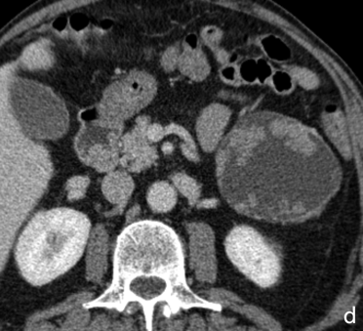
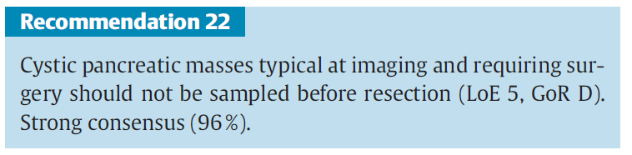
Complications to EUS-guided biopsy-specific complications
be a clinician not only an endosonographer
EFSUMB Guidelines, EJU 2016

Slide 14
Complications to EUS-guided biopsy-specific complications
ACUTE PANCREATITIS
the site of the puncture should be as close as possible to the pancreatic lesion to reduce transversing of normal pancreas
number of needle passes should be as low as possible: ROSE ?
EFSUMB guidelines , EJU 2016

Slide 15
Complications to EUS-guided biopsy-specific complications
PERFORATION
GI wall perforation during EUS FNA is generally due to the endoscopic instrument itself rather than to the needle and includes esophageal or duodenal perforation
Up to 24% of esophageal perforation after stricture dilation: DO NOT DILATE esophageal stricture for completing EUS(-FNA)
0.06% in a 2009 prospective trial
EFSUMB guidelines , EJU 2016
ESGE guidelines, Endoscopy 2017

Slide 16
Complications to EUS-guided biopsy-specific complications
TUMOR SEEDING
2003-2016 14 cases of needle tract seeding after EUS-FNA
11/14 after EUS-FNA of pancreatic masses
the transgastric needle track not resected: resectable tumors of body and tail of most concern!
EFSUMB guidelines , EJU 2016
ESGE guidelines, Endoscopy 2017

Slide 17
Complications to EUS-guided treatments
EUS-guided drainage of pancreatic fluid collections
EUS-guided Celiac plexus neurolysis/block
EUS-guided drainage of abdominal (non-peripancreatic) and pelvic collections
EUS-guided Biliary drainage
EUS-guided Pancreatic duct drainage
EUS-guided tumor treatment

Slide 18
Complications to EUS-guided drainage of pancreatic fluid collections
EUS guided drainage of symptomatic PFCs : transmural stents has mostly replaced surgery or percutaneous drainage
high success rate 87%-97%
low AEs 6%-34%, and mortality 0%-1% rates
Baron T, GIE 2002 Hookey LC, GIE 2006
Cahen D,Endoscopy 2005
Varadarajulu S, J Gastrointest Surg 2011

Slide 19
Complications to EUS-guided drainage of pancreatic fluid collections
Systematic review
bleeding (69 cases),
superinfection (52 cases)
stents migration that required endoscopic reintervention (51 cases)
perforation treated with surgery (27 cases) or conservatively (18 cases)
5 deaths procedure related
Fabbri C, WJG 2014
Total | 55 studies | 1867 pts | Complications 17% (0%-52%)

Slide 20
With advent of LAMS
after 2014….
RCT:
non-superiority
of LAMS
over plastic stents
for drainage
of WON
higher rate of
stent- related
adverse events
if LAMS not removed
within 3 weeks
Bang JY Gut 2018

Slide 21
Complications to EUS-guided drainage of pancreatic fluid collections
lumen-apposing metal stents or plastic stents?
Metanalysis of studies published since the revised Atlanta classification (2014 to current) included to estimate and compare the pooled rates of clinical success and adverse-events
pooled rate of clinical-success with LAMS 88.5% and with PS 88.1% P = 0.93
No difference was noted in the pooled rates of all adverse-events, LAMS: 11.2% (6.8-17.9, I² = 82.0) vs PS: 15.9% (8.4-27.8, I² = 78.8); P = 0.38
LAMS and PS demonstrate equal clinical outcomes and equal adverse-events in the drainage of pancreatic WON
Mohan BP, Endosc Ultrasound 2019

Slide 22
Complications to EUS-guided drainage of pancreatic fluid collections
Recommendations
LAMS must be removed after 3 weeks
NO LAMS if vascular lesions (pseudoaneurysms) in proximity

Slide 23
Complications to EUS-guided Celiac plexus neurolysis/block
Close to 2000 cases reported
Most frequent (up to 30% of patients) AEs: diarrhea, abdominal pain and hypotension, usually mild (grade I-II) and self-limiting
serious AEs reported: bleeding, abscess, abdominal ischemia, permanent paralysis and death
the risk of serious morbidity and mortality should be weighed against expected benefits particularly in patients with a long life expectancy (i.e. patients with chronic pancreatitis)
Fabbri C, WJG 2014

Slide 24
Complications to EUS-guided treatments
procedure | Reported cases | AEs rate (range) | Mortality rate
EUS –guided necrosectomy | 283 | 28% (0-46)
EUS-guided Biliary drainage | 1127 | 26% | 0.4%
EUS-guided ancreatic duct drainage | 248 | 20% (7-55)
EUS-GD of abdominal (non-peripancreatic) and pelvic collections | 120 | 13%
EUS-guided gallbladder drainage | 97 | 16%
Fabbri C, WJG 2014

Slide 25
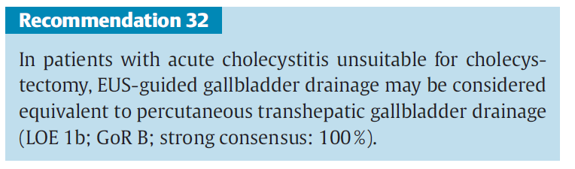
Complications to EUS-guided treatments- EUS-guided gallbladder drainage
non-inferiority RCT
to evaluate technical feasibility, efficacy and safety of
EUS-guided vs percutaneous drainage
59 patients
technical success rate (97% vs 97%)
clinical success (100% vs 96%)
adverse events (7% vs 3%, NS)
EFSUMB Guidelines, EJU 2016
Jang JW, Gastroenterology 2012

Slide 26
Complications to EUS-guided treatments of pancreatic cancer
Author, publication year | Study type | LoE | Therapeutic techniques | No. of patients | Technical success% | Response to treatment | Complications
Chang 2000 | Case series | 4 | Cytoimplant | 8 | 100 | Partial 3 | Iperbilirubinemia 3 Gastrointestinal toxicity 3
Nonogaki 2007 | Case series | 4 | Dendritic cells and gemcitabine | 5 | 100 | Partial 1; stable disease 2 | 0
Irisawa 2007 | Case series | 4 | Dendritic cells | 7 | 100 | Partial 3 | 0
Hirooka 2009 | Case series | 4 | Dendritic cells and gemcitabine | 5 | 100 | Partial 1; stable disease 2 | Hematologic toxicity 2
Hecht 2012 | Case series | 4 | TNFerade/chemoradiation | 50 | 100 | Complete 1; partial 2; stable disease 2 | Acute pancreatitis/cholangitis 3
Levy 2011 | Case series | 4 | Gemcitabine | 36 | 100 | 3 R0 resections | 0
Hecht 2003 | Case series | 4 | ONYX-015 | 21 | 100 | Partial 4; stable disease 6 | Infection 2 Duodenal perforation 2 Cystic fluid collection 1
Arcidiacono 2012 | Case series | 4 | RFA | 22 | 72 | NA | Abdominal pain 3 Bleeding 1 Jaundice 2
Scopelliti S 2018 | Case series | 4 | RFA | 10 | 100 | NA | 0

Slide 27
Complications to EUS-guided injection of pancreatic cystic lesions
Author, publication year | Study type | LoE | Therapeutic techniques | No. of patients | Technical success% | Response to treatment | Complications
Gan 2005§ | Case series | 4 | Ethanol lavage | 25 | 100 | Complete 8 | 0
Oh 2008 | Case series | 4 | Ethanol lavage-paclitaxel | 14 | 100 | Complete 11 | Acute pancreatitis 1
DeWitt 2009* | RCT | 1b | Ethanol lavage vs saline lavage | 25 vs 17 | 100 | Complete 14 | Abdominal pain 10 Intracystic bleeding 1 Acute pancreatitis 1
Oh 2009^ | Case series | 4 | Ethanol lavage-paclitaxel | 10 | 100 | Complete 6 Partial 2 | 0
Oh 2011 | Case series | 4 | Ethanol lavage-paclitaxel | 52 | 100 | Complete 29 | 0
Di Maio 2011+ | Case series | 4 | Single vs double ethanol lavage | 13 | 100 | Complete 5 | Abdominal pain 1
Caillol 2012° | Case series | 4 | Ethanol lavage | 13 | 100 | Complete 11 | 0
DeWitt 2014 | Case series | 4 | Ethanol lavage-paclitaxel | 22 | 100 | Complete 10 Partial 5 | Acute pancreatitis 3 Peritonitis 1
Oh 2014 | Case series | 4 | Ethanol lavage-paclitaxel | 10 | 100 | NA | Intracystic bleeding 1 Abdominal pain 5 Vomiting 1

Slide 28
Complications to EUS
CONCLUSIONS
remind absolute and relative contraindications to liver biopsies
antibiotic prophylaxis/treatment if infection risk
be a clinician not only an endosonographer: integrate clinical and imaging data
know/use all different available techniques, including transcutaneous: choosing wisely = choosing safely
….KNOW EUS-RELATED ADVERSE EVENTS!

Slide 29

….EUS e tanto altro al maggior evento della Gastroenterologia IT…..

