Slide 1
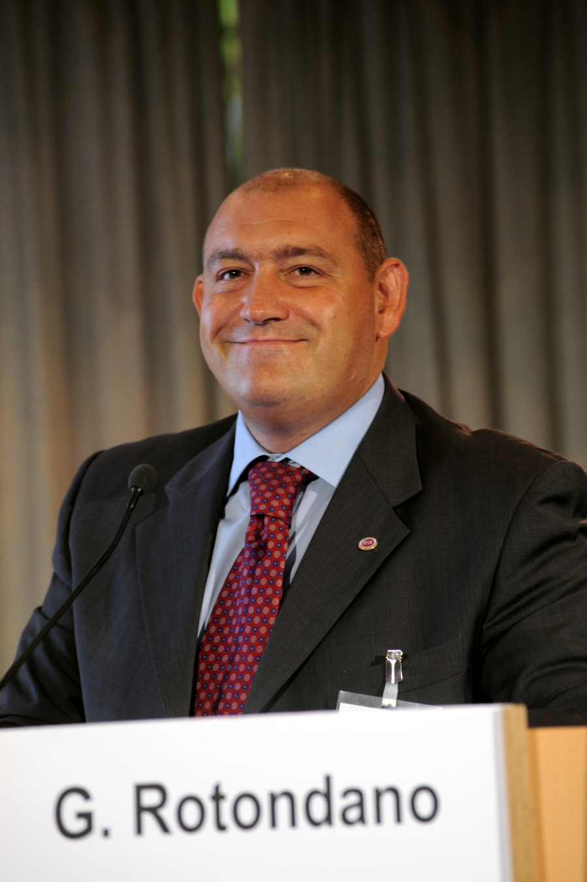

Slide 2
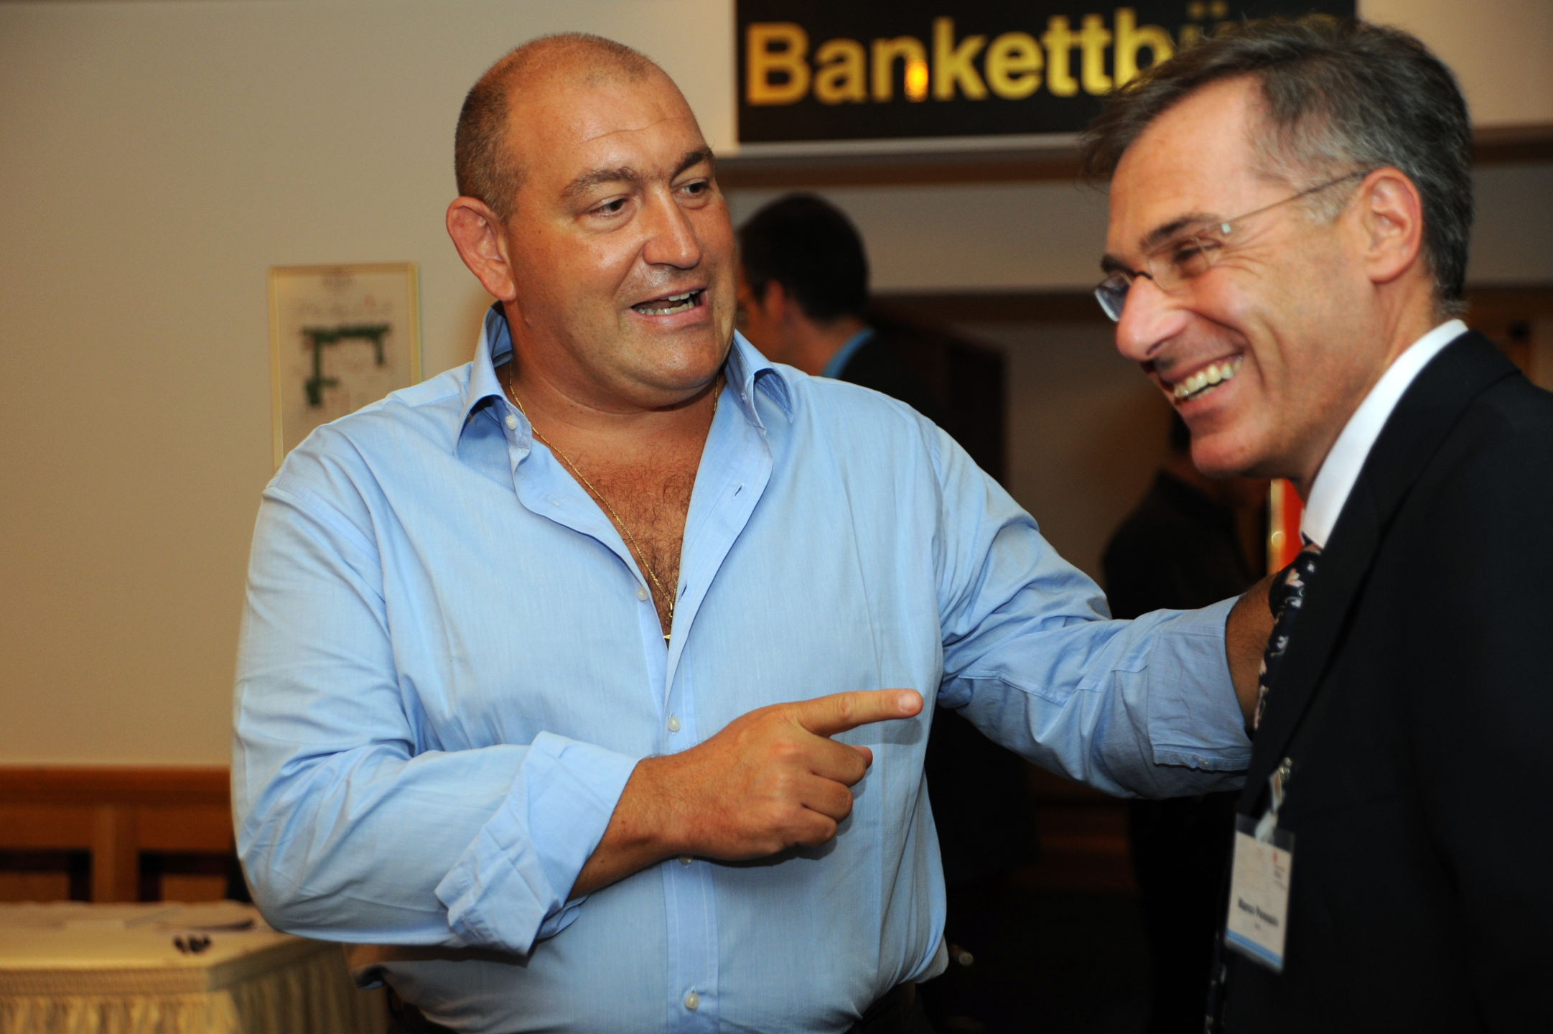

Slide 3
Complications in Endoscopy
CONVIVERE NEL QUOTIDIANO
SIED Udine 2019
Peter N. Meier, MD, FASGE, FEBG
Hannover, Germany

Slide 4
What is a complication?
cerebral ischemia after cessation of warfarine before sphincterotomy
hypoxia during colonoscopy, managed by supportive care
acute bleeding after polypectomy, managed by clipping
depressive patient with suicidal obsessions after Propofol
55-year old man having colonic carcinoma and liver metastases 5 years after uneventful screening colonoscopy

Slide 5
Is a complication
?
an unavoidable problem
„part of the game“
bad luck

Slide 6
DEFINITIONS
something went wrong
  > adverse event
something was done wrong
  > negligence
something went wrong while nothing was done wrong
  > complication

Slide 7
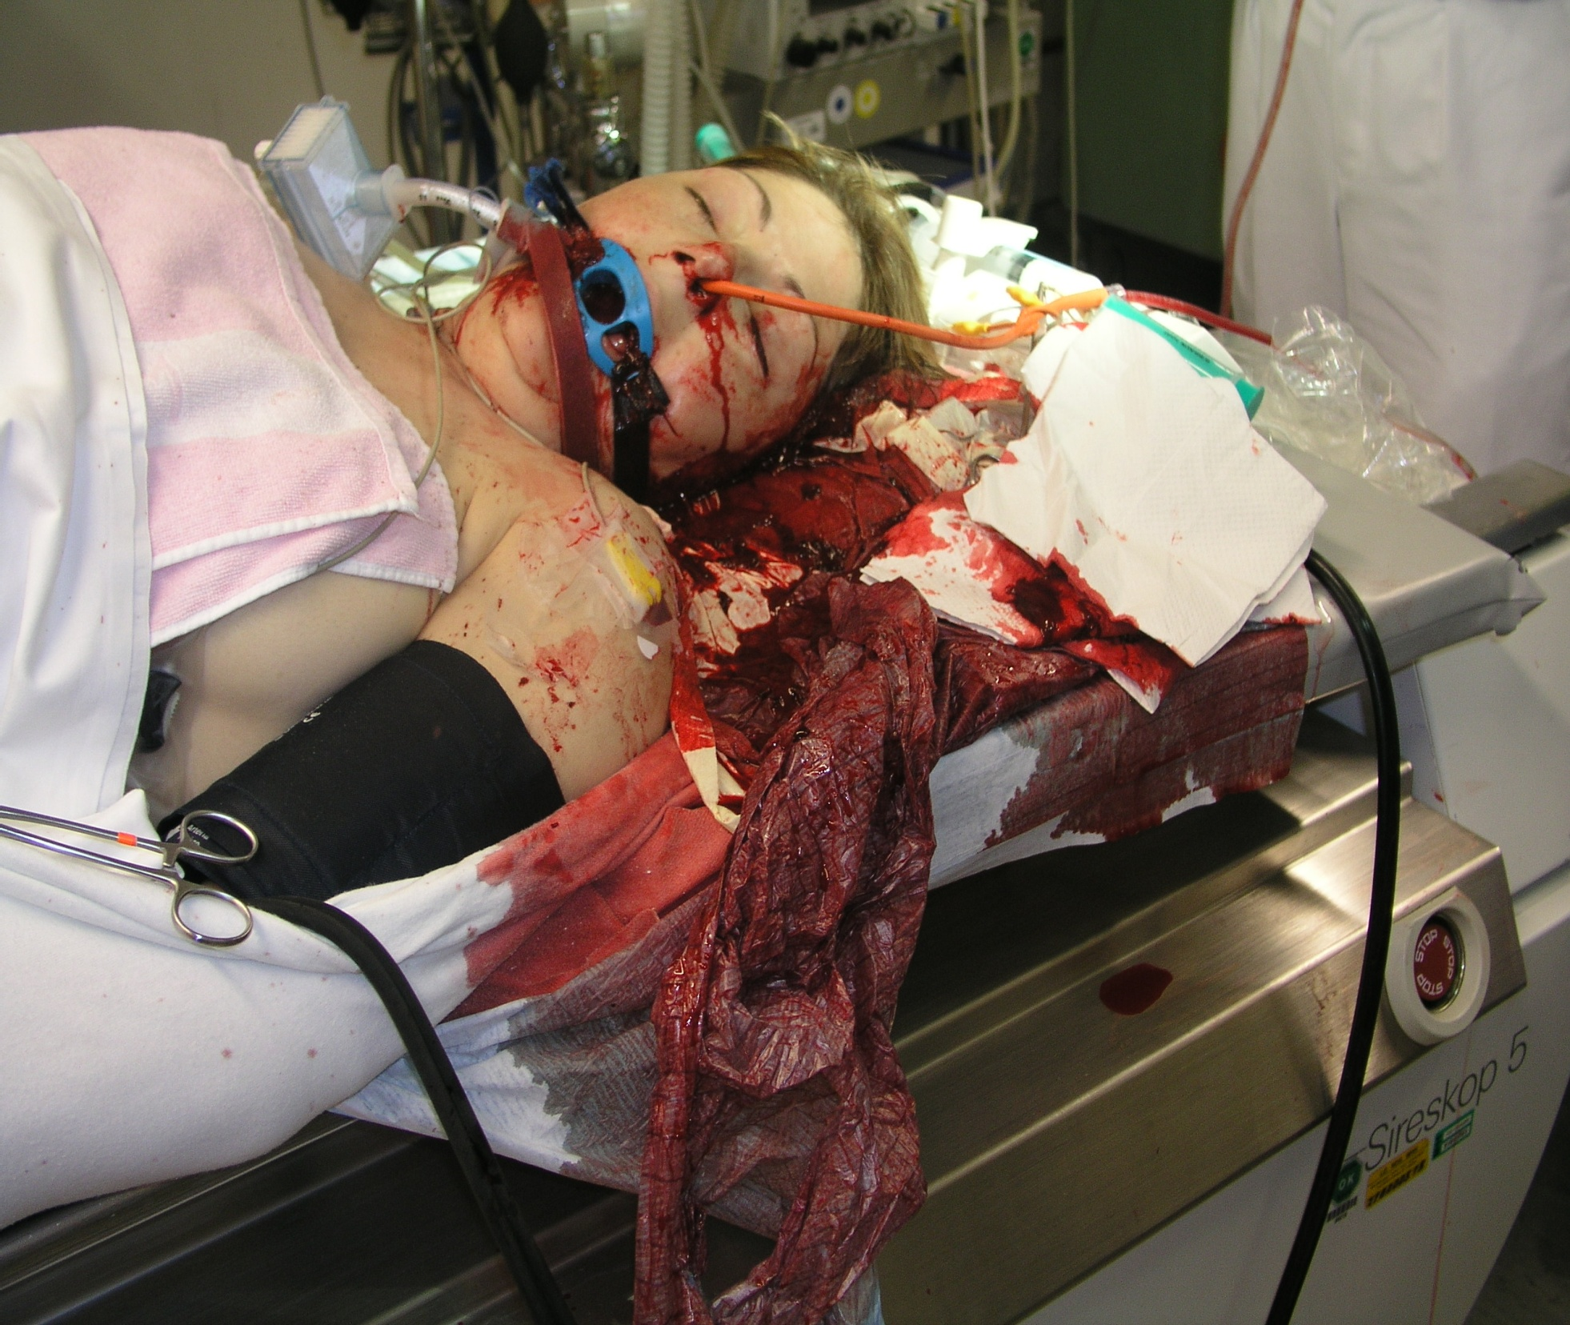
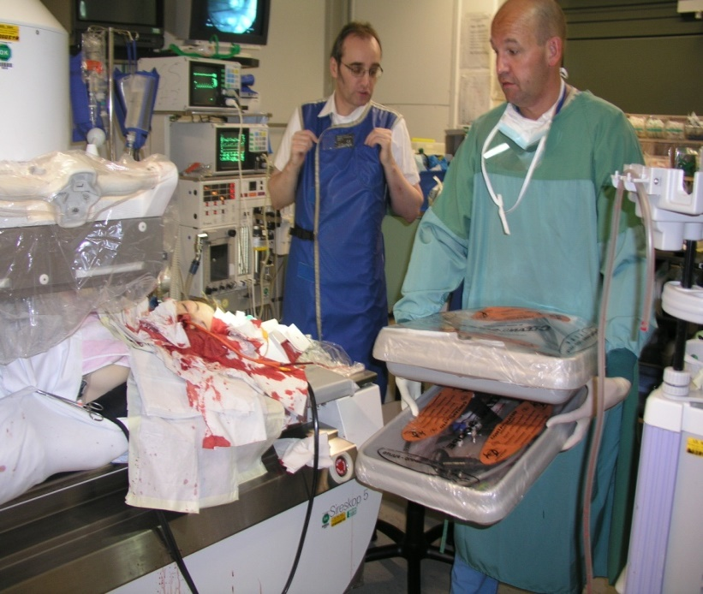

Slide 8
ADVERSE EVENT
The neutral term
Doesn’t tell you anything about the cause of the event

Slide 9
NEGLIGENCE
The doctor has worked below the required level of care
The problem could, and should, have been avoided
The doctor and/or hospital are/is liable for damages

Slide 10
COMPLICATION
A problem which could not have been avoided
“All in the game”
“Bad luck”
No legal consequences, unless there is a lack of informed consent

Slide 11
DUTY TO INFORM
Information about relevant complications to be expected (and about alternative ways of treatment) before receiving informed consent from the patient
The occurence of a complication can have legal consequences if the doctor has failed to inform properly

Slide 12
WHY DO PEOPLE SUE DOCTORS?
has been answered in The Lancet (1994, vol. 343) by Charles Vincent et al.
still valid
both emotional and social-economic reasons

Slide 13
Why do patients sue their physicians?
severe handicap of working ability, family and social life
unsensible or incomplete communication after the event
Today‘s opponent is your yesterday‘s patient !

Slide 14
…what about the incidence of endoscopic complications?
There are lies,
there are bad lies
and there is statistics

Slide 15
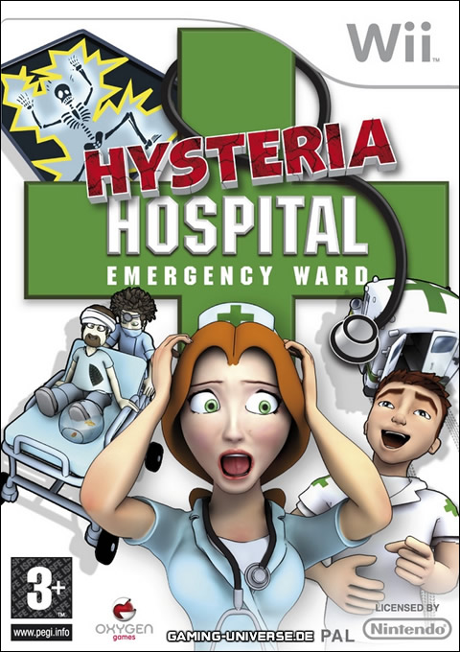
Complications have to be
- anticipated
- recognized
- reacted on
- communicated
- documented
- analysed

Slide 16
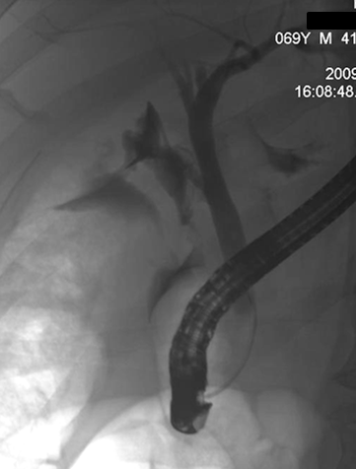
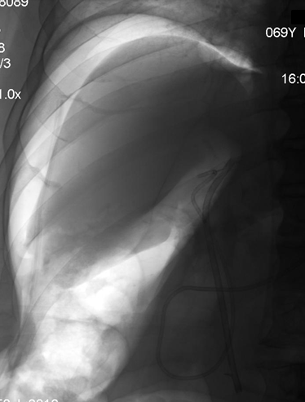
Recognize
Cystic duct insufficiency
Notes:
16

Slide 17
Recognize
Looking for typical complications
    X-ray control (with contrast) after dilatation?
    abdominal finding/palpation post colonoscopy?
    Emphysema during ESD or Dilatation?
    ERCP: free air post procedure?
Notes:
17

Slide 18
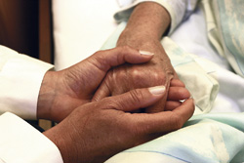
Communication

Slide 19
The time line of communication about complications
Complication
Before
the procedure
Procedure
After
the procedure
Communicate about
the complications
Communicate because of
the complication
Communicate
the complication

Slide 20
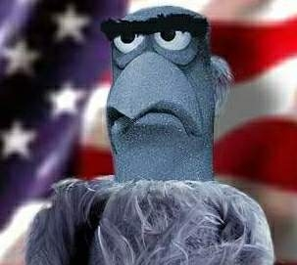
What?
The Truth !

Slide 21

When the complication is recognized…
When to communicate?
  Immediately
By whom
  Personal involved
  Direct information
To whom?
  The patient himself
  The family
  The family doctor/ referring physician
  The surgeon/ radiologist

Slide 22
Bad News…
Chosing the right surroundings
Chosing the right language
Clear speach, time for questions
Enough time for answers
Summarizing the event and further steps

Slide 23
Document
Clear detailed and „true“ honest report
Immediate documentation – stepwise
  Detailed physicals with date and time
  Documentation of consultations and decisions
  Visual (picture, video, file) documentation if possible
Complication summary for medical record
Notes:
23

Slide 24
Act!
Induce appropriate interventional actions to
  minimize
  reverse
  avoide
  further deterioration of the complication
Notes:
24

Slide 25
A quick reaction results in a better outcome
Surgical treatment of oesophageal perforations
 | % Deaths
 | Treatment < 24h | Treatment > 24h
Bladergroen et al. 1986 | 15 | 33
Nesbitt et al. 1987 | 11 | 26
Sandasagra et al. 1978 | 20 | 35
Ajalat et al. 1984 | 0 | 33
Michel et al. 1981 | 11 | 29
Moghissi et al. 1988 | 30 | 56
Larsen et al. 1983 | 13 | 33

Slide 26
New Tools?
YES!
via EMR/ ESD/ NOTES

Slide 27
New Tools for
Hemorrhage
Perforation
Infection
Drainage
(sedation)

Slide 28
Hemorrhage
pharmacologic Tx
injection
thermal Tx
mechanical Tx
hemospray

Slide 29
Perforation
therapeutic principles:
adaptation
covering
drainage

Slide 30
Perforation
primary closure
- clipp, suture
stent
drainage

Slide 31
Perforation: SEMS
fully covered
duration 1-2 Monate
diameter 22m
change after 4 weeks

Slide 32
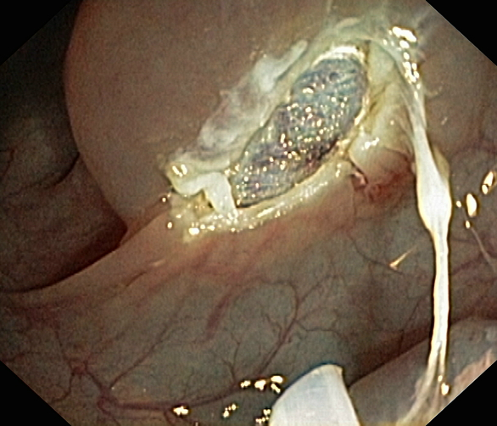
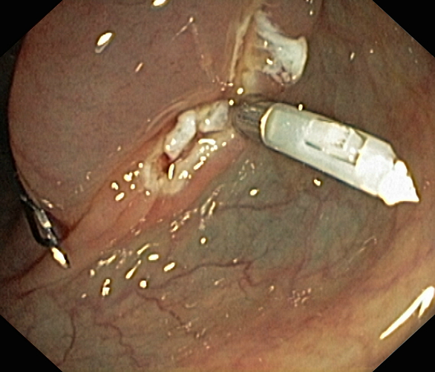

Slide 33
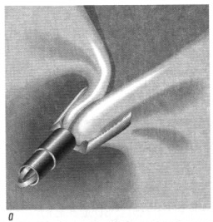
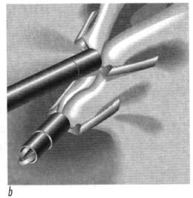
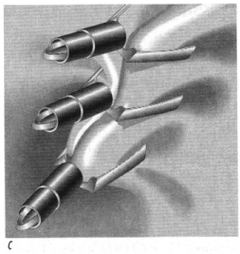

Slide 34
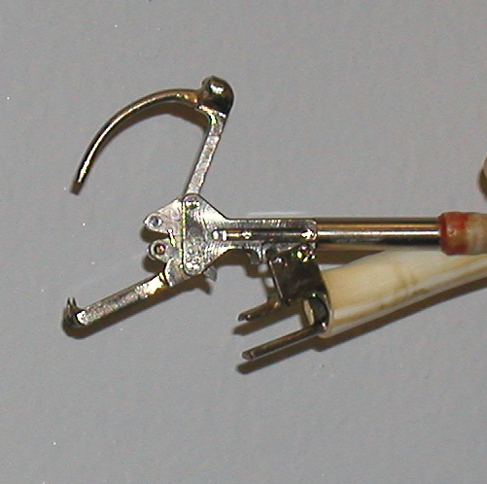
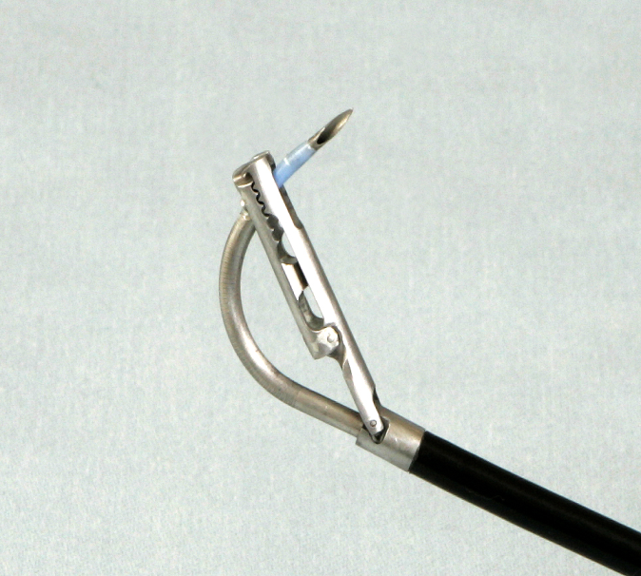
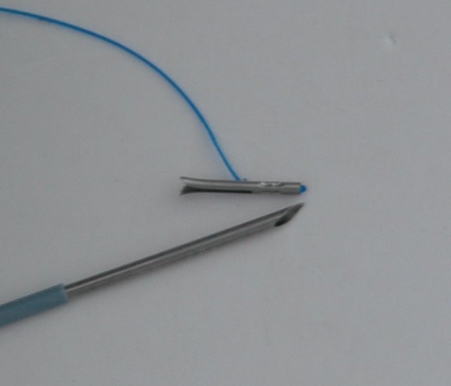
suturing
still experimentel

Slide 35
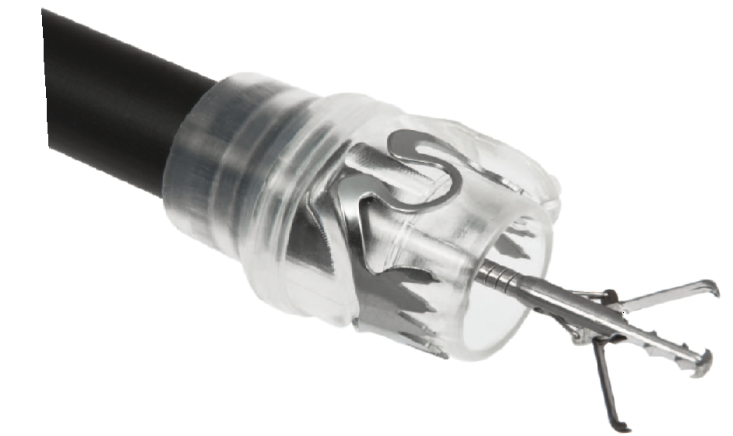
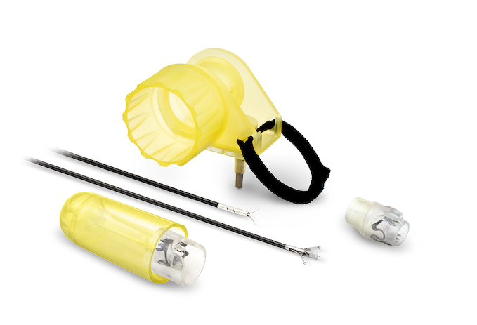
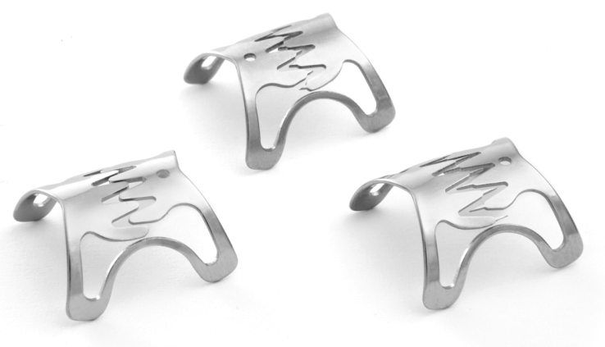
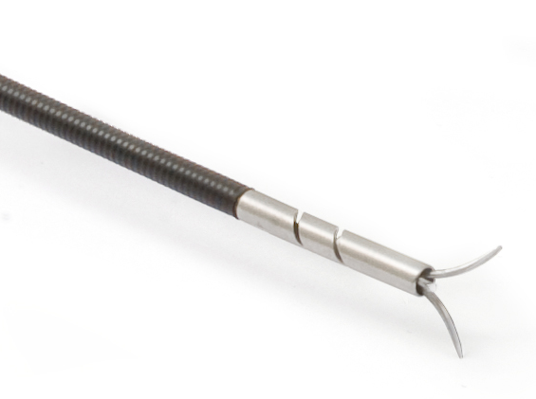
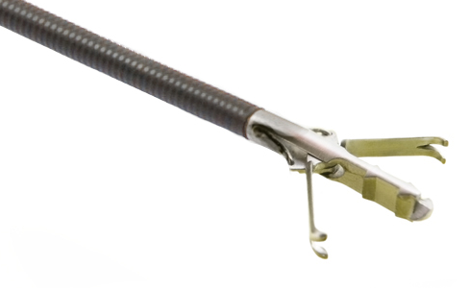

Slide 36
sponge
= therapy of septic/ infected wounds

Slide 37
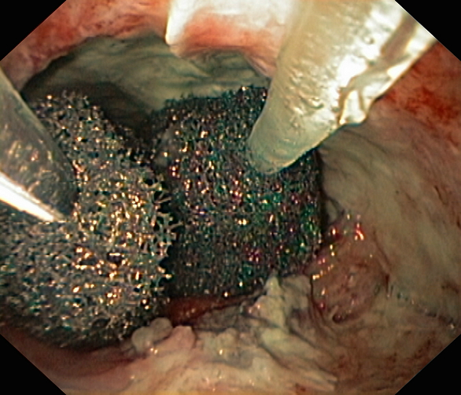

Slide 38
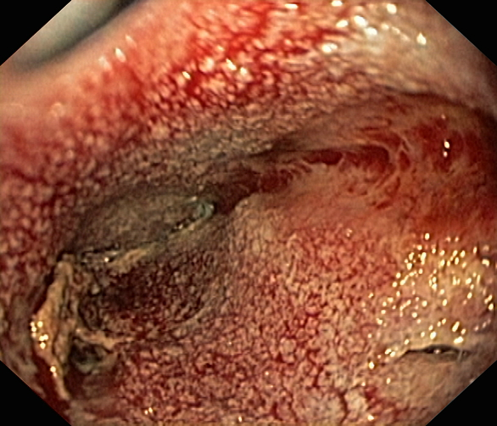

Slide 39
Strategies to improve patients care
Critical incidence report systems (CIRS)
registries
morbidity- mortality-conferences
definition of standards
Team-Time-Out
certifications

Slide 40
Team-Time-Out

Slide 41
Development of safety-related skills: Lifelong Learning!
Basic Training „Human Factors“:
Introduction into Human Factors
Human Factors in flight
Application of competencies in regard to teamwork
Pilot´s performance in modern cockpits
Command Course
and/or Upgrade
Competency
MPL
Captains Advanced
Trainings
Counseling on
personal development
Counseling on
leadership development
Training Captain
TRI/TRE
Check-Captain
Leadership Competence
Development
Training First Officer
FOFL
Type Rating, Jet Orientation, Supervision
CRM Recurrents / Refreshers
Security
Safety + Emergency
Dangerous Goods
CRM
Initial
MCC
Flight School,
esp.HPL
Initial Screening
Basic Cockpit Training
Advanced Cockpit Training
Time
Cardozo, Hannover 2011

Slide 42
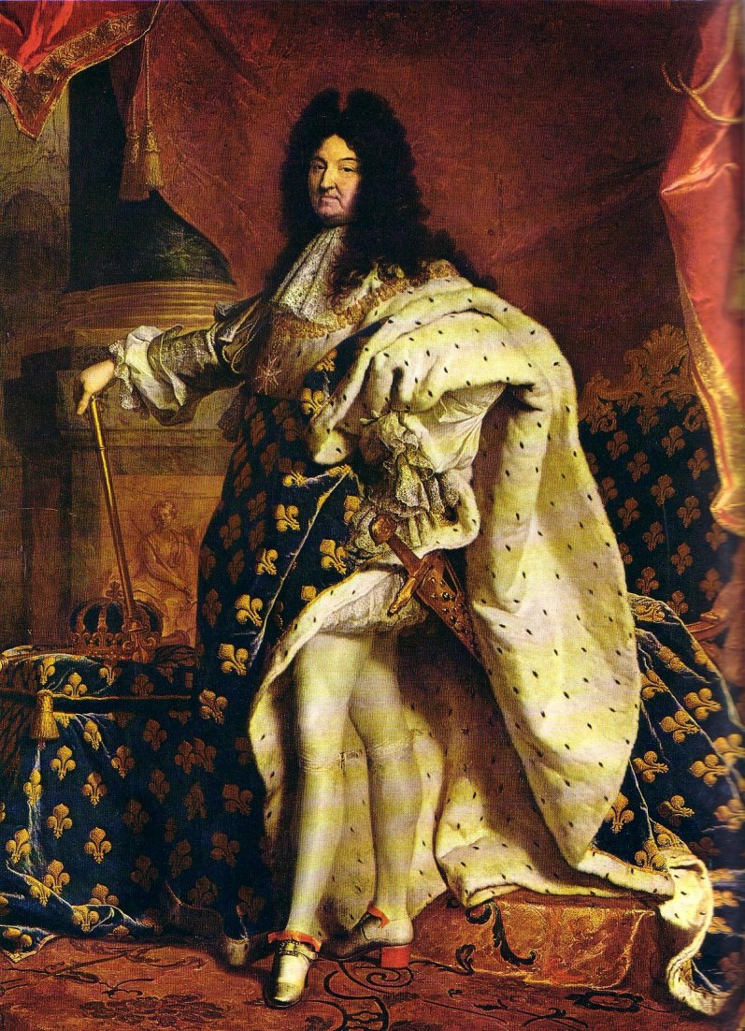
No absolutism in endoscopy !

Slide 43
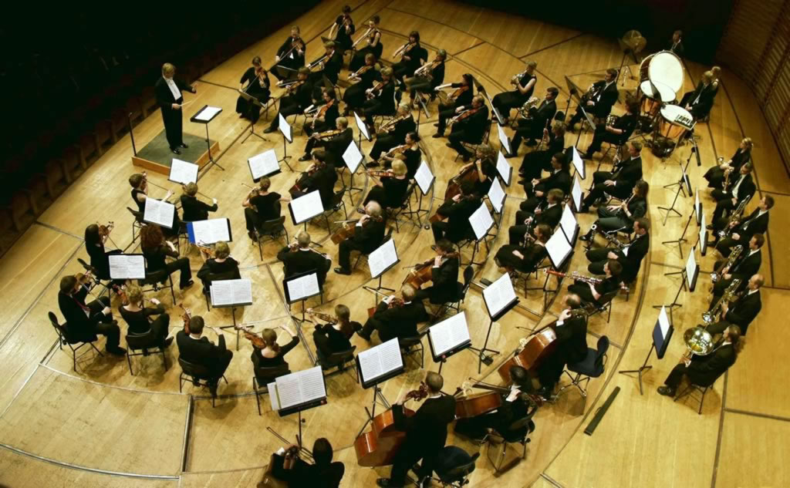
Team conference

Slide 44
Conclusions
Communicate a complication is always a painful time
The better prepared and the more experienced physicians are, the less difficult the task will be
Always orientate decisions on scientific evidences and seek multidisciplinary advice
Frankness, humility, humanity are the keywords

Slide 45
