Slide 1
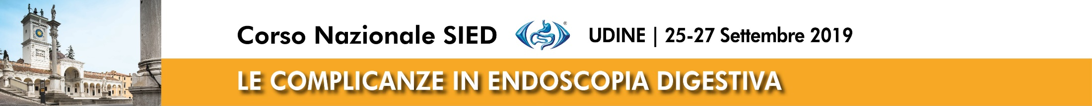


S.C. di Endoscopia Digestiva ed Interventistica

Slide 3
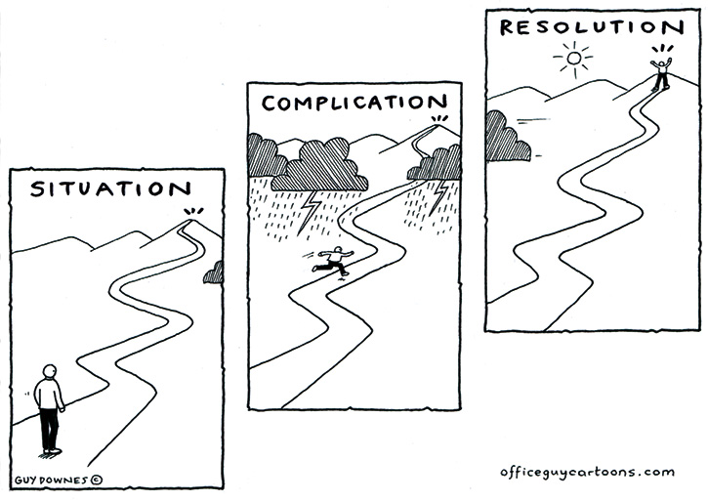
How to manage ERCP complications?

Slide 4
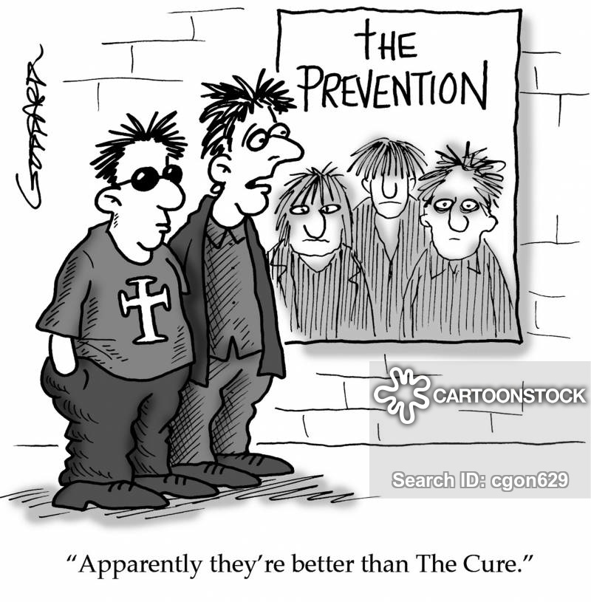

Slide 5
Post ERCP complications
Acute pancreatitis
Post ES bleeding
Perforation

Slide 6


Slide 7
PEP diagnosis
Asymptomatic patients: no need to dose amylasis and lypase after ERCP.
Post ERCP abdominal pain: clinical evaluation at 24 h → persistent pain: blood test (amylasis x 5 n.v.; wbc). If PEP: CT scan after 72 h
Post ERCP severe pain: severe PEP with secondary compartment syndrome? Retroperitoneal perforation? → CT scan and blood test asap

Slide 8
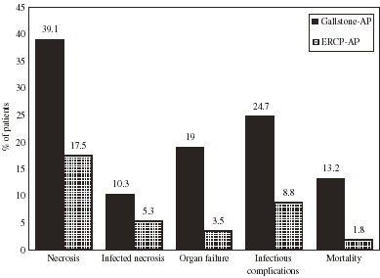

57 acute pancreatitis on 1497 ERCP (3.8%)
V Bathia et al; J Clin Gastroent 2006

Slide 9
Post-ERCP pancreatitis
Unpredictable and unavoidable?
Can be prevented?
Patient selection
Pharmacological prophylaxis and fluid therapy
Technical maneuvers

Slide 10
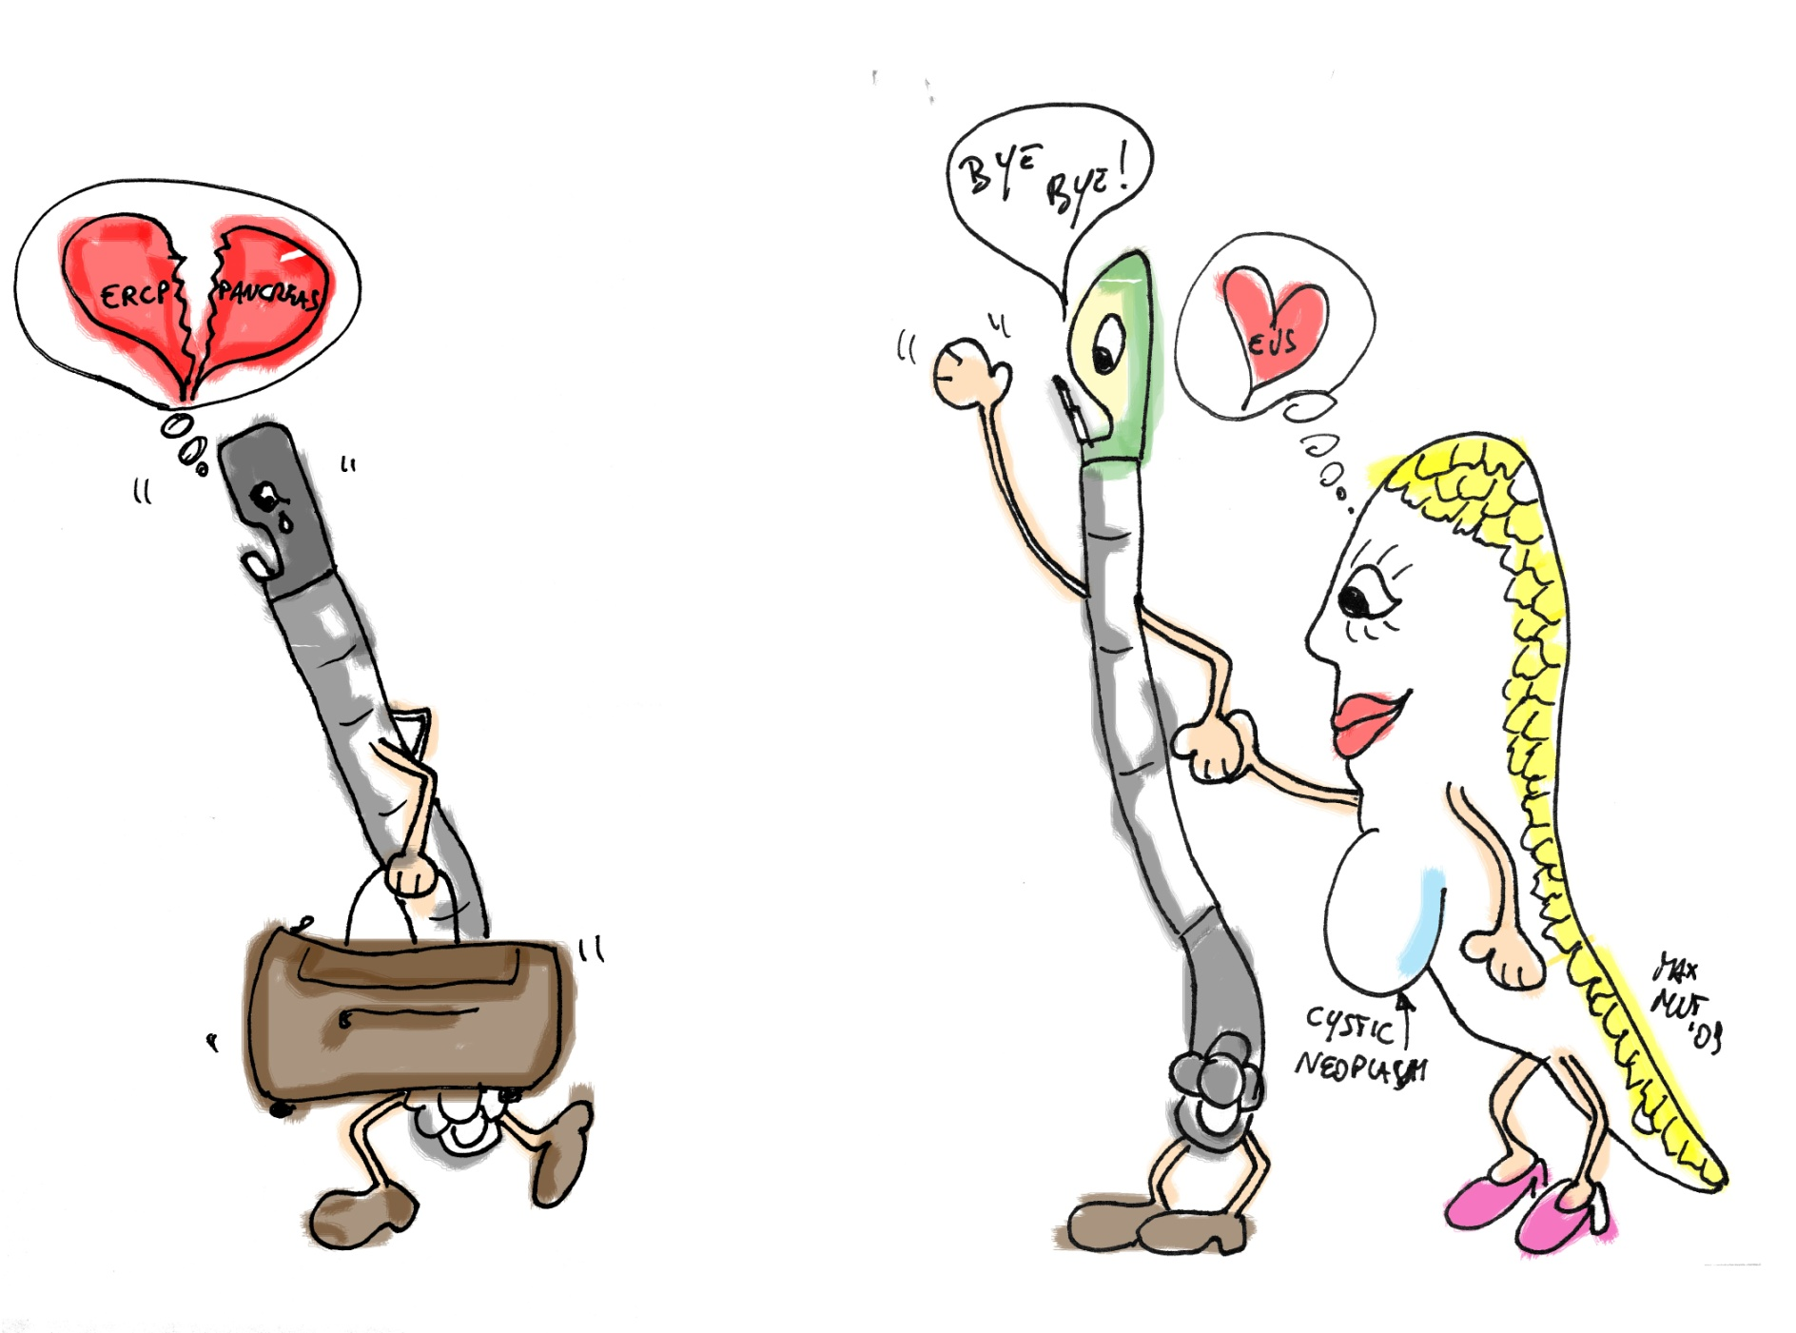
Diagnostic ERCP

Slide 13
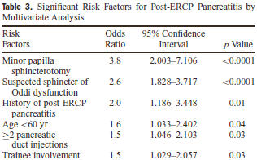

Slide 14
What is impact of nonsteroidal anti-inflammatory drugs in the prevention of PEP:
A meta-analysis of randomized controlled trials

Slide 15
What is impact of nonsteroidal anti-inflammatory drugs in the prevention of PEP:
A meta-analysis of randomized controlled trials

Slide 16


Slide 18

Guide Wire CM injection
Acute pancreatitis (n°) none < 0.01 8
mild - 6
moderate - 1
severe - 1
Cannulation rate (%) 100 100
Cannulation time (min) ? ?
Gastrointest Endosc 2004

Slide 22
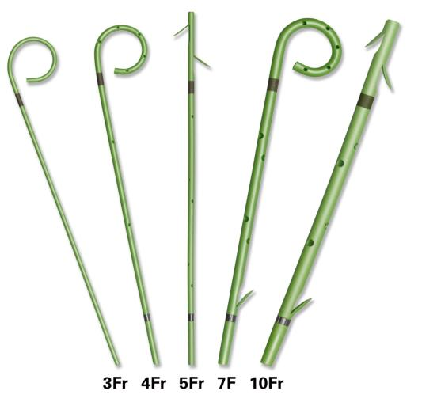
Pancreatic stents

Slide 23


Slide 24
NSAID-Stent
NSAID

Slide 25
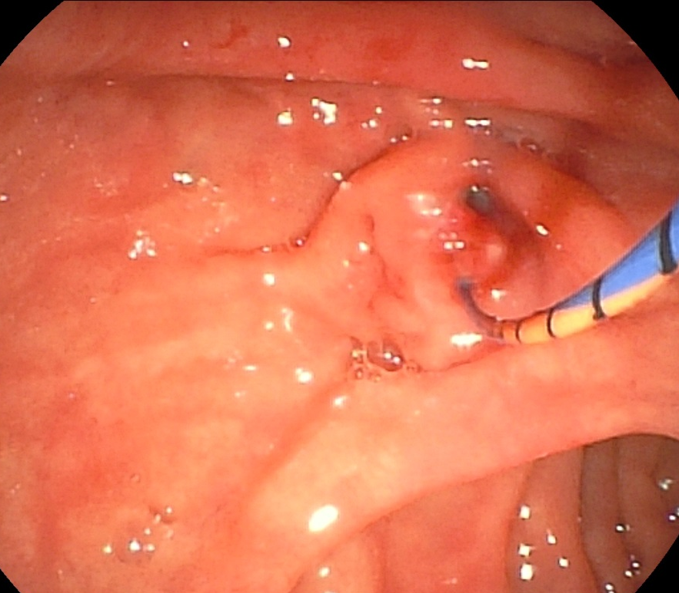
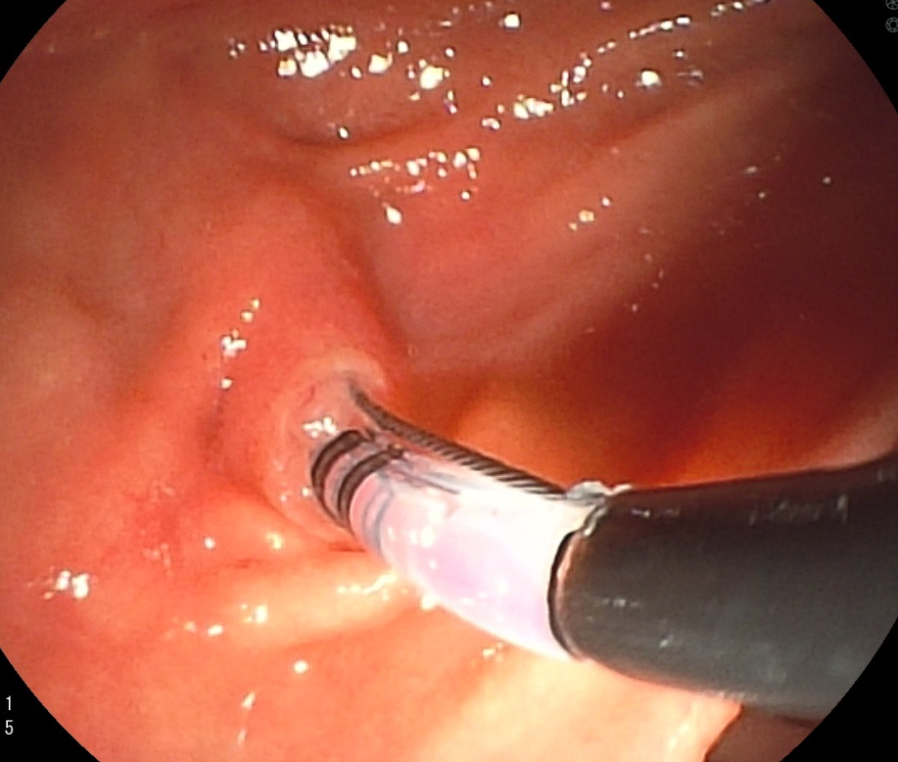
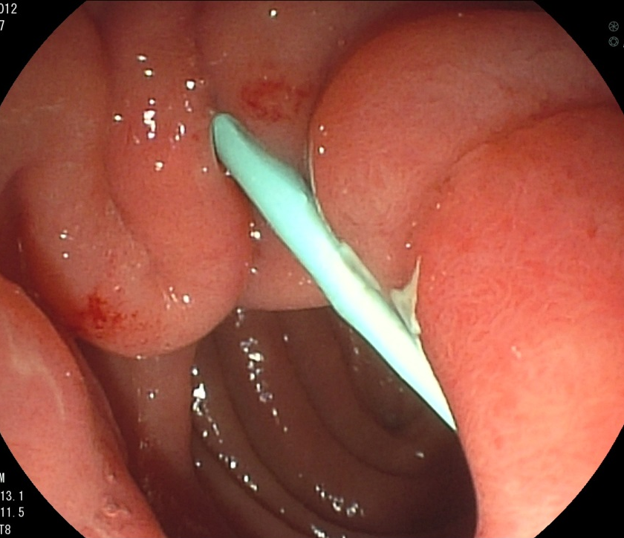

High risk patient for PEP: 5 fr pancreatic stent after EBS
IPMN?

Slide 26


Slide 29
Prevention of post-ERCP pancreatitis
“Bring to home”
Careful patient selection (avoid unnecessary/inappropriate ERCP)
Prefer guide-wire cannulation techniques
Move the guidewire and inject dye kindly!
Use pure cut or “endocut current” for Sphx
Prophylaxis with NSAID always
Pancreatic stent only in high risk patients
Aggressive Hydratation
Biliary stent without sphincterotomy if Wirsung is normal?

Slide 30
Post ERCP complications
Acute pancreatitis
Post ES bleeding
Perforation

Slide 31
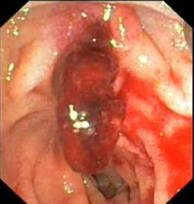
Post-Sphincterotomy Bleeding
Incidence ranges widely 1-48%!
Because of different definitions
Immediate
(If controlled is not a complication)
Delayed
(hours/days after the procedure)
The complication!

Slide 33
DOACs
DRUG | TRADE NAM | MECHANISM OF ACTION | PHARMACOKINETICS |  |  | ANTIDOTE
 |  |  | ROUTE OF ADMINISTRATION | HALF LIFE (hr) | PEAK CONCENTRATION (hr)
Dabigatran etexilate mesylate | Pradaxa | Direct thrombin inhibitor. Target— factor II | Oral | 12–17 | 2–3 | Idarucizumab— Praxbind
Rivaroxaban | Xarelto | Direct factor Xa inhibitor | Oral | 7–13 | 2–4
Apixaban | Eliquis | Direct factor Xa inhibitor | Oral | 12 | 1–4
Edoxaban | Lixiana | Direct factor Xa inhibitor | Oral | 9–11 | 1–2

Slide 34

When to resume DOACs?
No studies available
Conflicting guidelines
Real life data

Slide 35

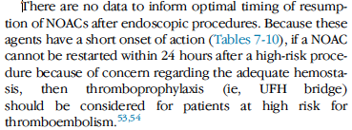
ASGE, Gastrointestinal Endoscopy 2016

Slide 36

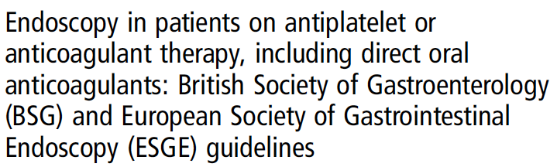
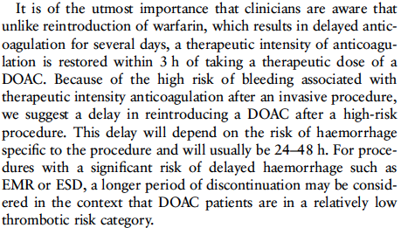
Veitch AM, Vanbiervliet G, Gershlick AH, et al. Gut 2016

Slide 37
Radaelli F, Fuccio L, Paggi S, et al. Gut 2019

Slide 38
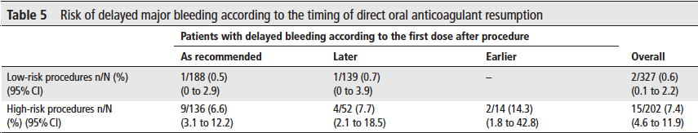
When to resume DOACs?
ERCP without sphyncterotomy 7 (2.1% of low-risk procedures)
ERCP with sphincterotomy 19 (9.4% of high-risk procedures)
Incidence almost twice as high in patients with resumption of anticoagulation earlier than recommended by the BSG/ESGE guidelines (14.3% vs 6.6%, p=0.27 ns).
unsafety of heparin bridging in DOAC patients,
Radaelli F, Fuccio L, Paggi S, et al. Gut 2019
Notes:
Prospettico, multicentrico, ottima definizione di assunzione periprocedurale dei DOACs, basata sulle linee guida ESGE/ BSG.
The risk of delayed bleeding likely to result in additional exploitation of medical and economic resources was sensitive to the time of resumption of DOAC therapy.
In particular, any anticipation as compared with the BSG/ESGEr ecommendations tended to result in a higher bleeding risk, and it should be strongly discouraged.
We consider this difference to be of high clinical impact, although statistical significance was not achieved, as it was lower than the needed 26.5% risk difference, calculated post hoc based on our study sample.

Slide 39
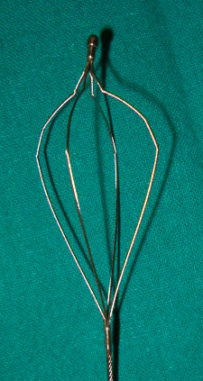

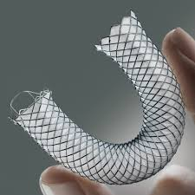
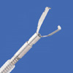
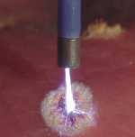
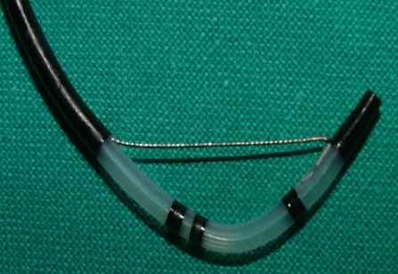
Post-Sphincterotomy Bleeding
How to treat
The duodenoscope
Single-use
clip

Slide 40
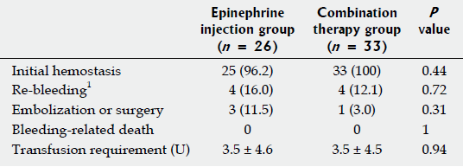

Slide 42
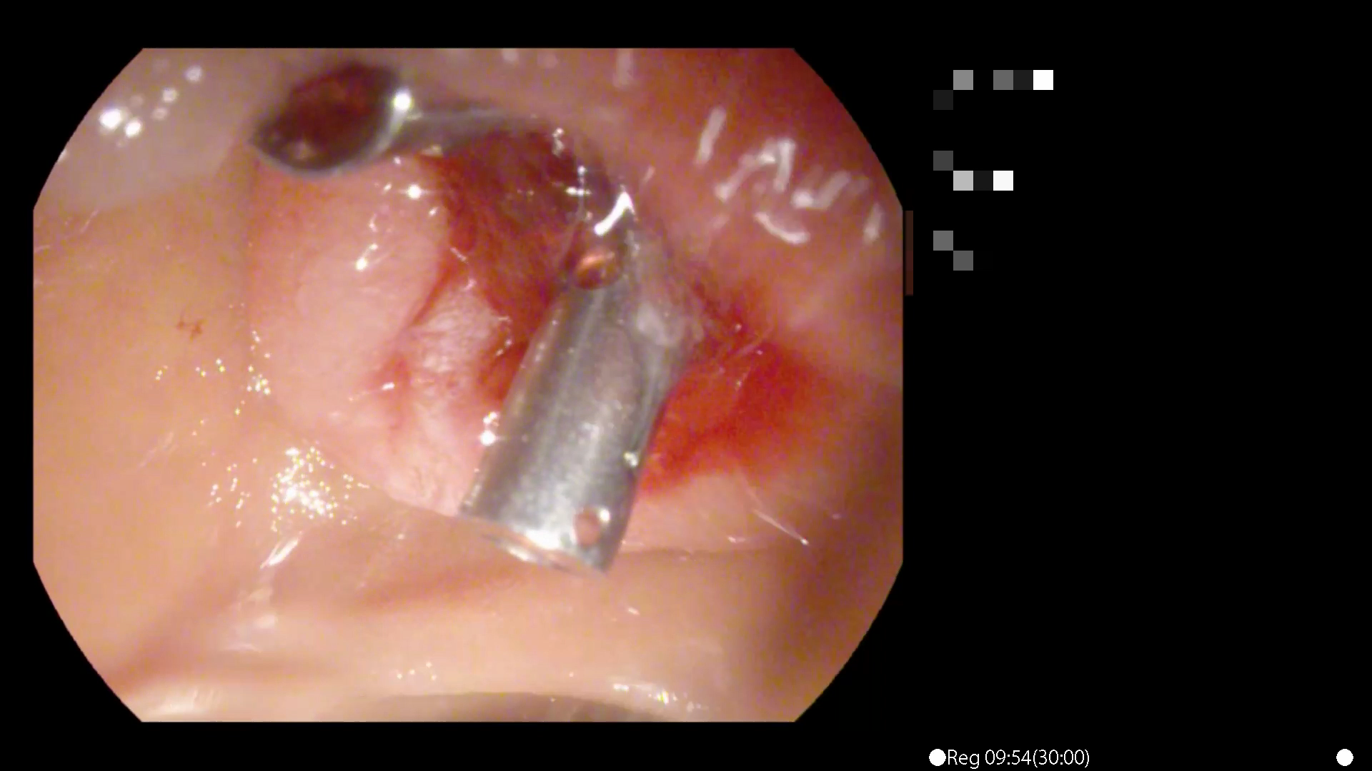
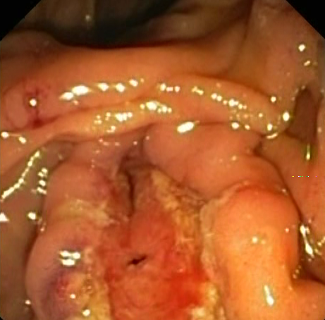
Post-Sphincterotomy Bleeding
Where to inject, burn, close

Slide 43
Site of injection
Papilla major

Slide 45
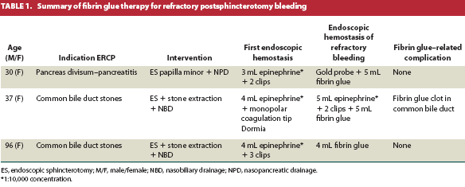

Slide 46
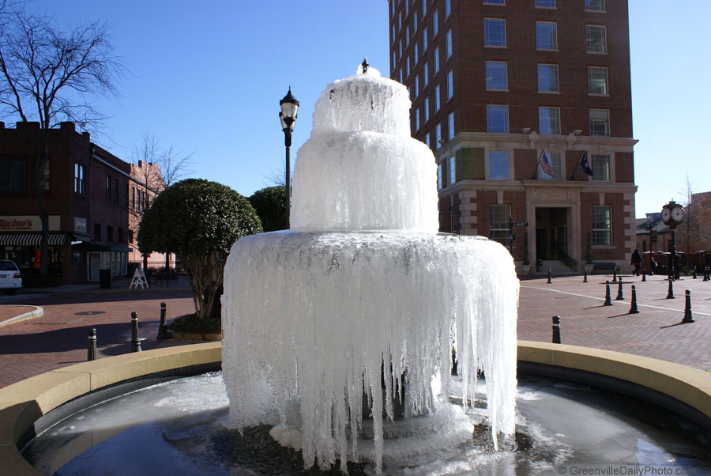

Magic powders
Floseal, hemospray and other…

Slide 48
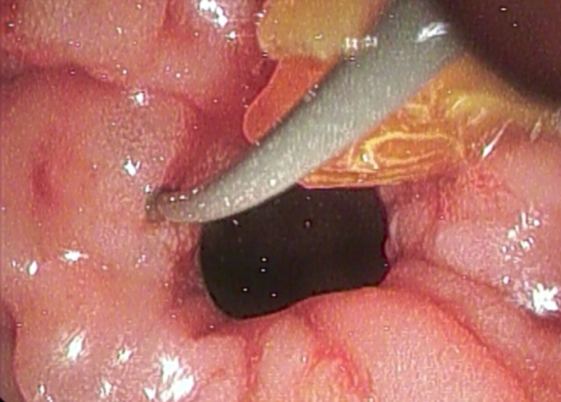
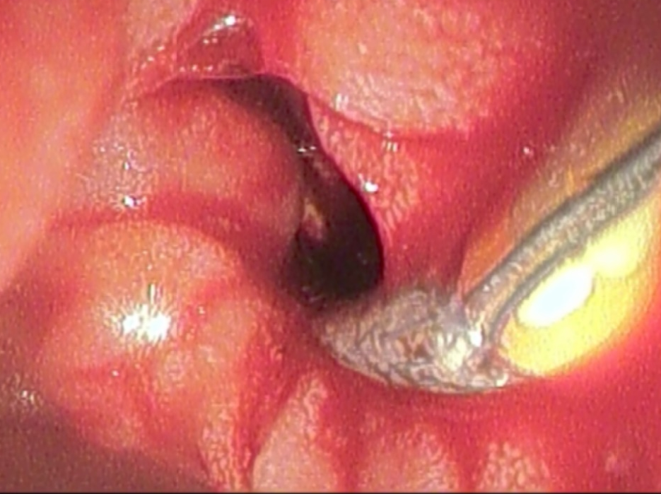
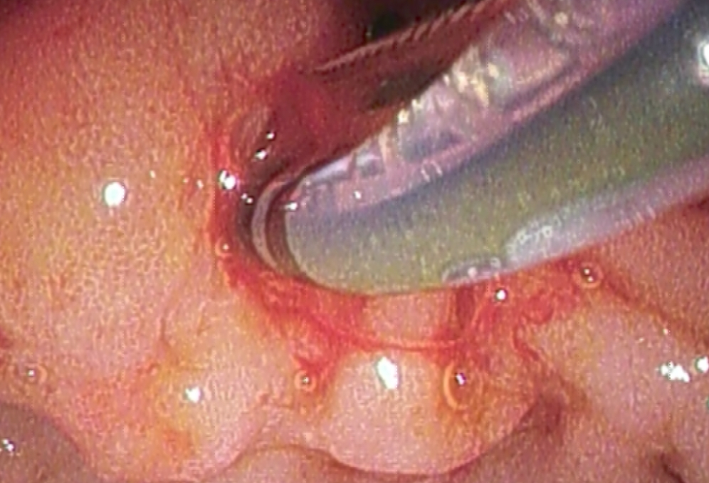
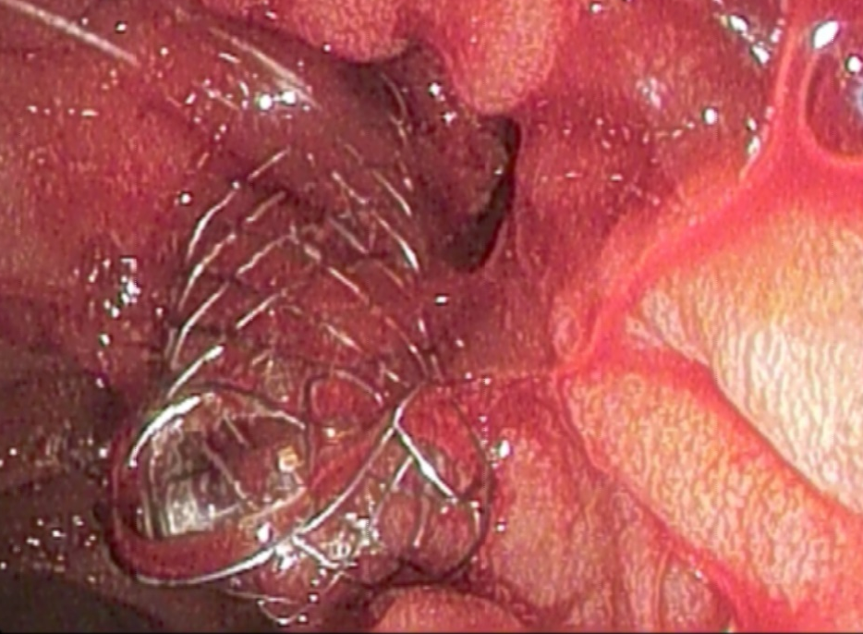
Post EBS bleeding: SEMS

Slide 51


Slide 52
Post ERCP complications
Acute pancreatitis
Post ES bleeding
Perforation

Slide 53

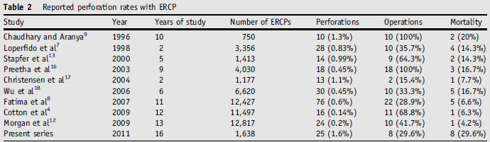

Slide 54
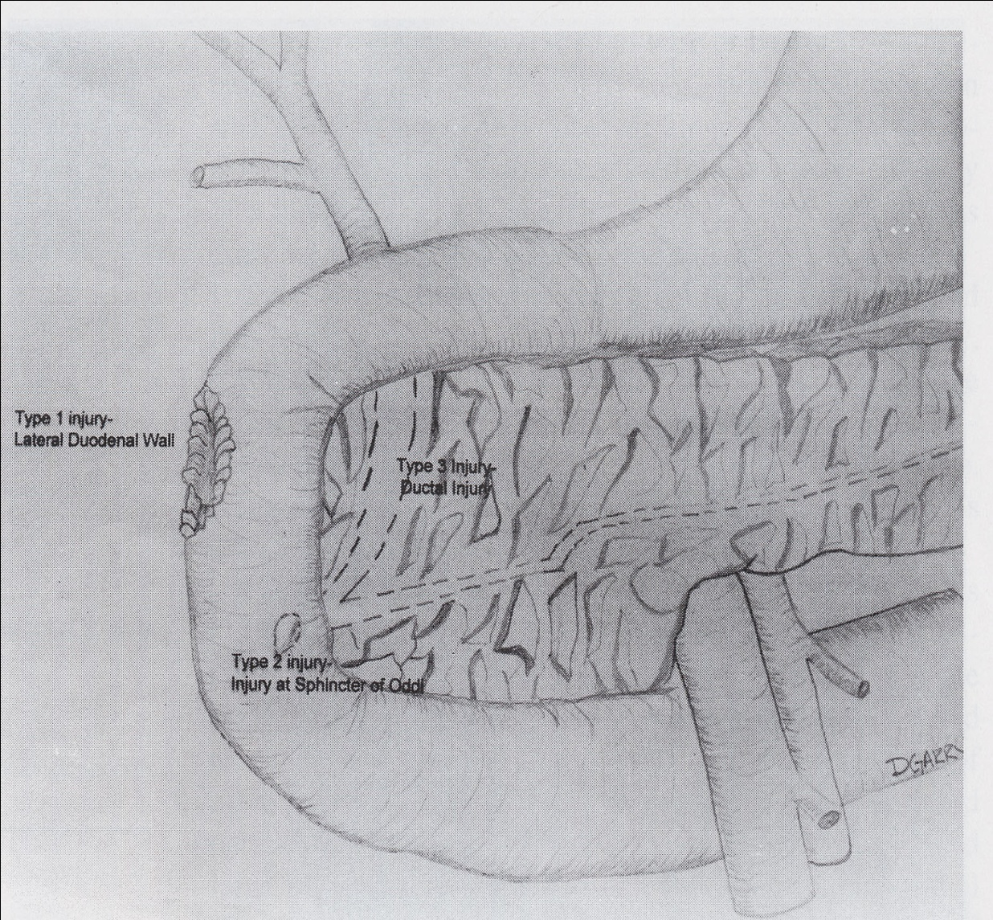
Duodenal perforation due to ERCP: classification
Stapfer et al. Management of duodenal perforation after ERCP and sphincterotomy. Ann Surg 2000

Slide 55
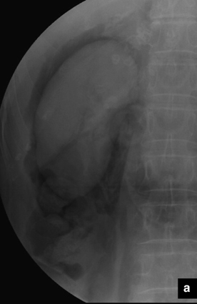
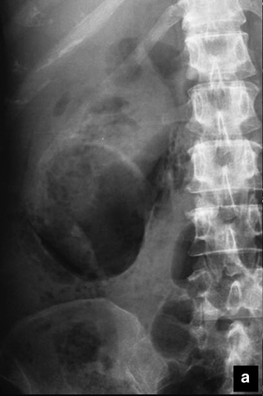
Rx abdomen

Slide 56
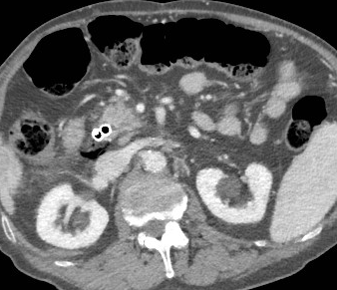
Suspect of post ERCP perforation: CT scan

Slide 57
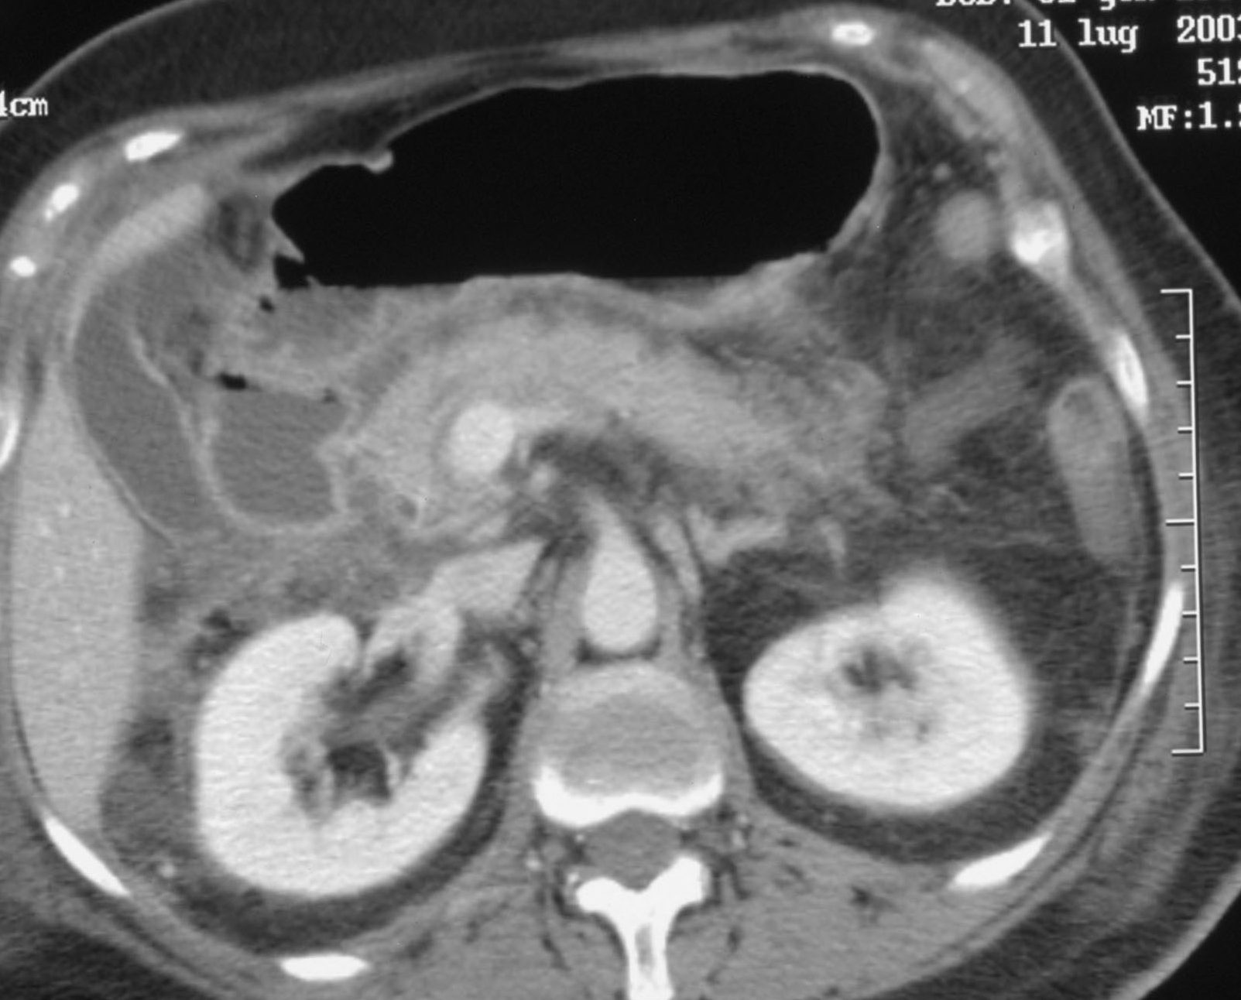
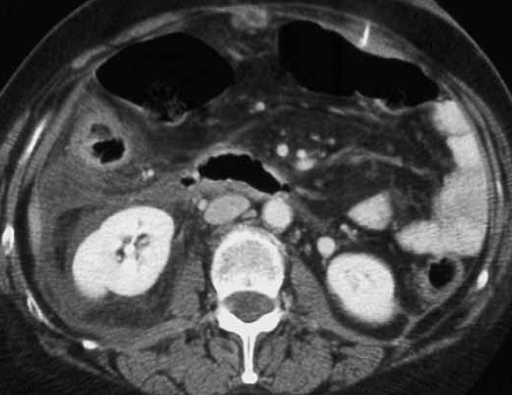
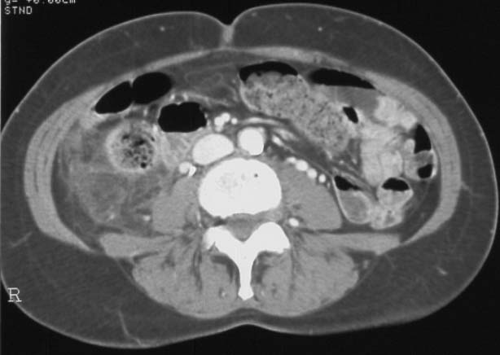
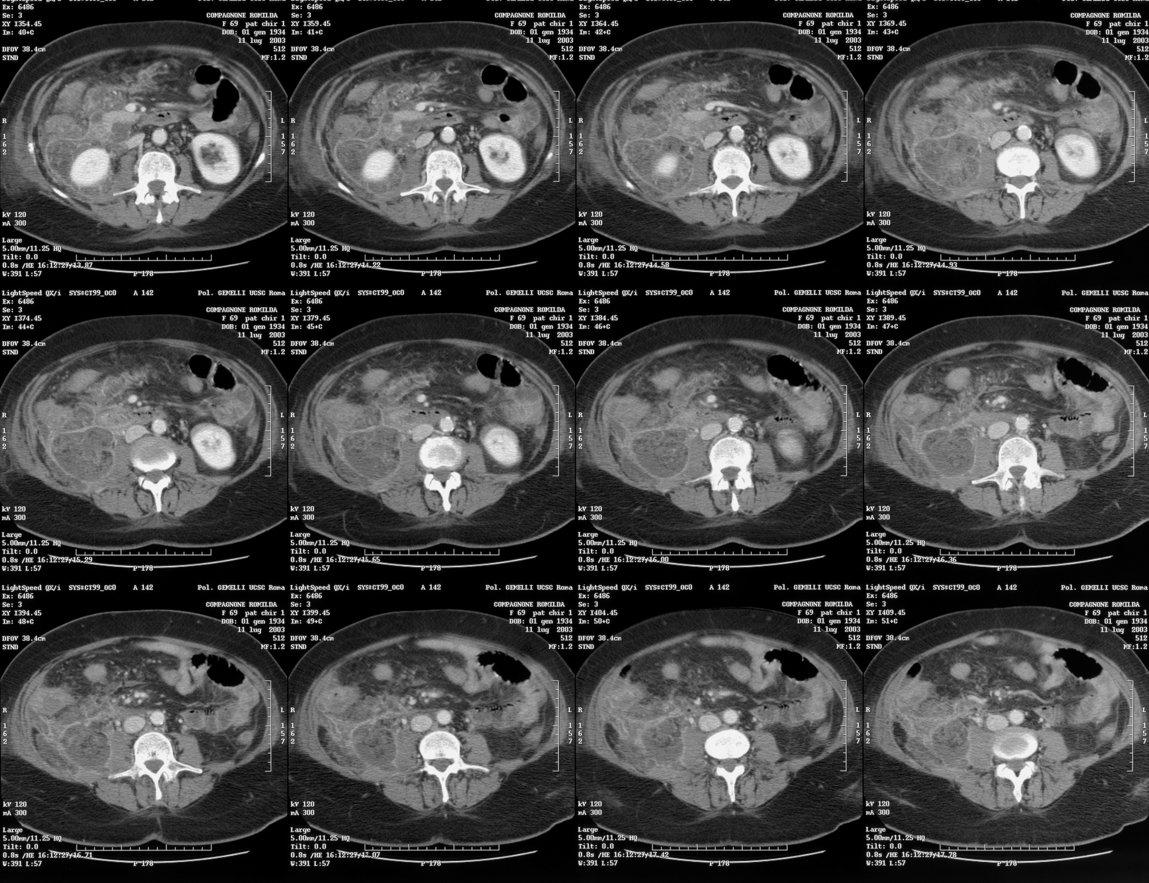
Duodenal perforation
with retroperitoneal fluid collection

Slide 58
Duodenal perforation Type I
What to do?

Slide 59
Duodenal perforation Type I
What to do?
Immediate primary endoscopic repair or surgery asap!!!

Slide 60
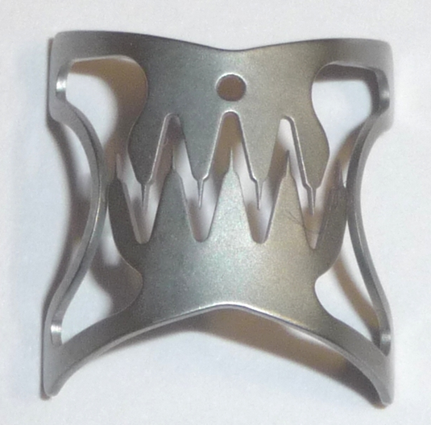
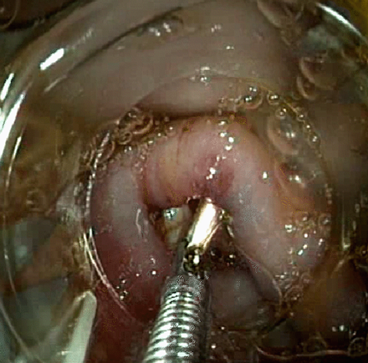
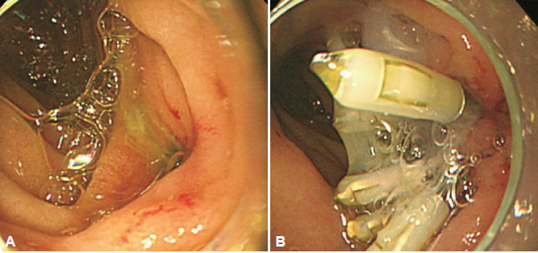
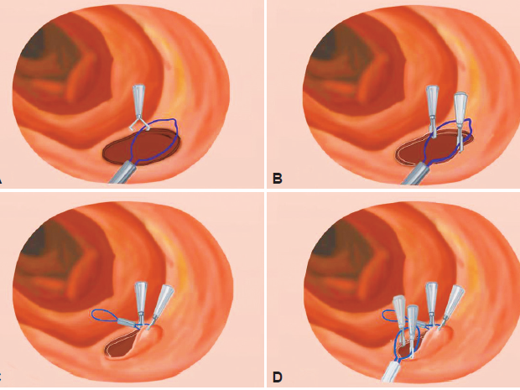
Primary endoscopic repair

Slide 61
Duodenal perforation Type II
What to do?

Slide 62


Duodenal perforation Type II: what to do?
PPI/somathostatin
Antibiotics
Parenteral nutrition
Naso gastric/duodenal tube
Naso-biliary drainage or percutaneous drainage

Slide 63

Duodenal perforation Type II
But nowdays?
(only in case of early diagnosis without sign of sepsis!!!!)

Slide 64
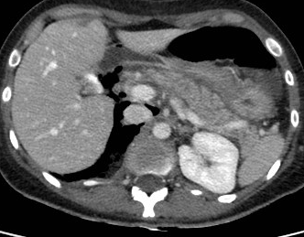
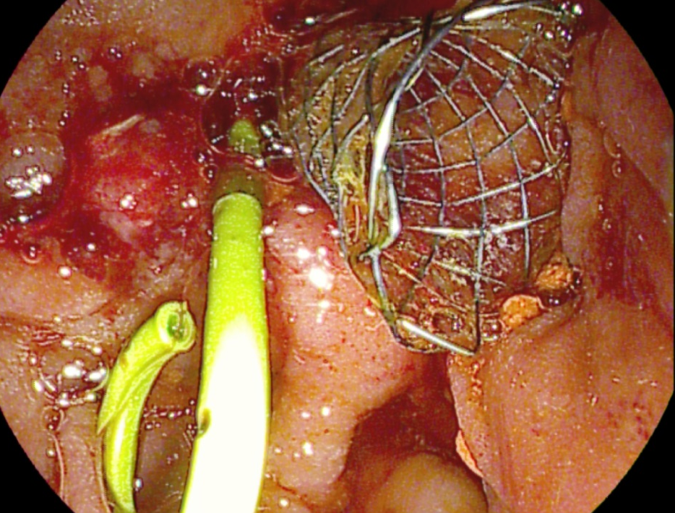
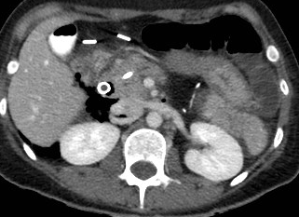
Duodenal perforation Type II after papillectomy
Bleeding 10 hours
after papillectomy

Slide 65
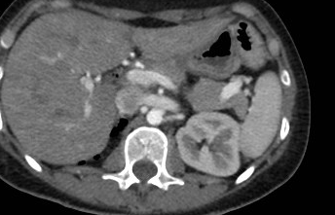
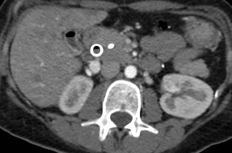
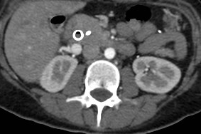
Duodenal perforation Type II after papillectomy
6 days after perforation

Slide 66
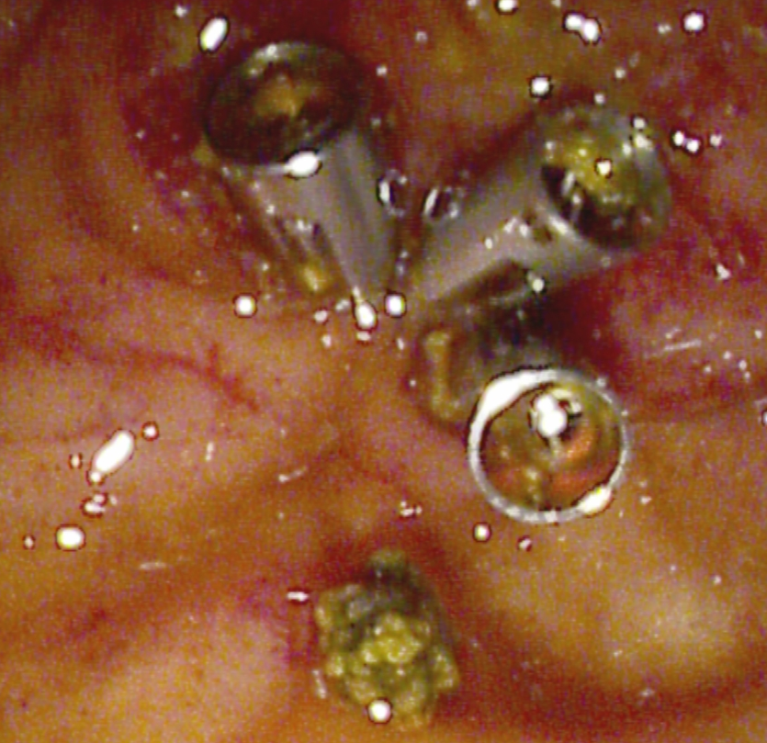
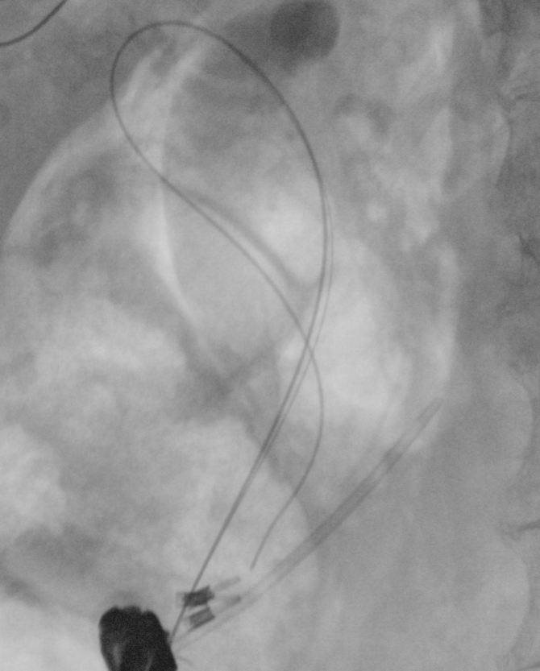




Stapfer type II perforation after DASE

Slide 68

C-SEMS in type II post ERCP perforation
Is there an I.O. contamination of the retroperitoneal space?
Notes:
68

Slide 69
Post ERCP perforation
Indication for surgery/percutaneous drainage
Type I perforation not repaired endoscopically
Fever/sepsis
Retroperitoneal fluid collection
Peritonitis

Slide 70


Slide 71
Post ERCP perforation indication for surgery
Type I perforation not repaired endoscopically
Fever/sepsis
Retroperitoneal fluid collection
Peritonitis
Do we need to wait for this symptoms before
to operate?

Slide 74


Slide 75



Stapfer type II and III perforation
10 days after the ERCP, admission in our ICU with OTI
Perihepatic hematoma
Perirenal fat imbibition
Retroperitoneal free air
Procalcitonin and
Lactate normal

Slide 76



Stapfer type II and III perforation
1 fc-SEMS 10 mm 6 cm
4 plastic stent 8.5 fr 9-12 cm
6 month later

Slide 78


Type III post ERCP perforation
Guide wire into the liver

Slide 79


Type III post ERCP perforation
Intrahepatic and subglissonian infected hematoma

Slide 82



Slide 84


Slide 85
Definition of training
A satisfactory training process must involve
Knowledge
Skills
Attitude
COMPETENCE
Awareness
J.R.B. GREEN & THE UK ERCP STAKEHOLDERS

Slide 86
How to manage ERCP complications?

Slide 87

Complications to ERCP
Una scomoda verità Una comoda bugia
Gino Pasquale
lecture
Mutignani
lecture

