Slide 1
Le complicanze
della colangiopancreatografia
retrograda endoscopica
La Perforazione
Caso clinico
Dario Raimondo
UO di Endoscopia Digestiva e Gastroenterologia
Fondazione Istituto Giglio di Cefalù

Slide 2
Caso clinico
Paziente di sesso femminile di 57 anni
Nessuna patologia degna di nota all’anamnesi
Nel 06/2019 si reca in PS a causa di ittero improvviso, nausea e vomito
In PS vengono eseguiti esami siero ematochimici, ecg, con evidenza di rialzo degli indici di colestasi (AST: 175 UI/L, ALT 378 UI/L ; bilirubina tot 4.8 mg/dl, bilirubina diretta 3.7/dl; lipasi 1862 UI/L; amilasi 404 UI/L; FA 333 UI/L; GGT 1613 UI/L)
Ferritina 156,12ng/ml
Nessuna alterazione di emocromo, creatinina, azotemia ed ECG.
La paziente esegue ETG addome completo

Slide 3
Caso clinico

Slide 4
Caso clinico
La paziente viene ricoverata presso presso la Medicina D’urgenza
Indicazione ad eseguire colangio RM

Slide 5
Caso clinico

Slide 6
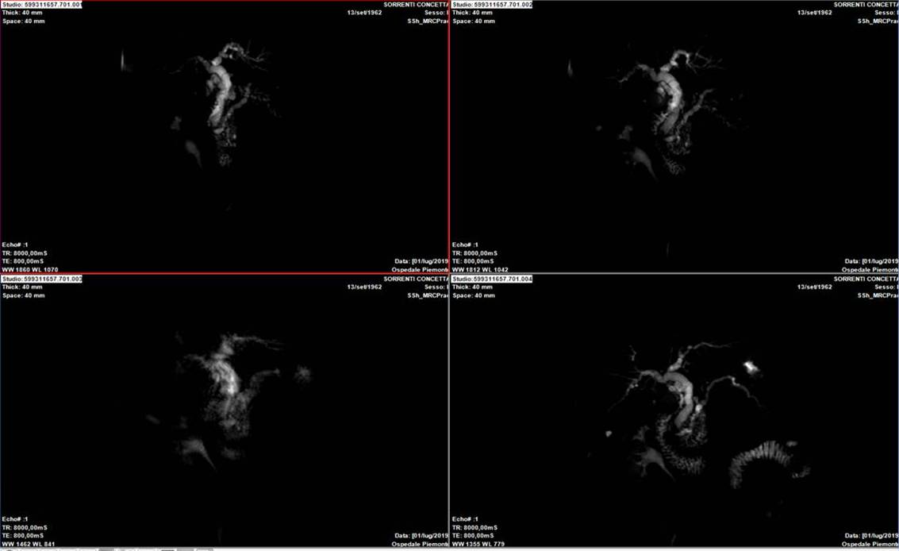
Caso clinico
Colangio RM

Slide 7

Caso clinico
Colangio RM

Slide 8
Caso clinico
A distanza di 5 giorni dall’accesso in ps, ulteriore incremento degli indici di colestasi , riduzione di amilasi e lipasi.
Condizioni cliniche generali: buone
Si decide di eseguire ERCP previa contestuale ECOENDOSCOPIA + FNA

Slide 9
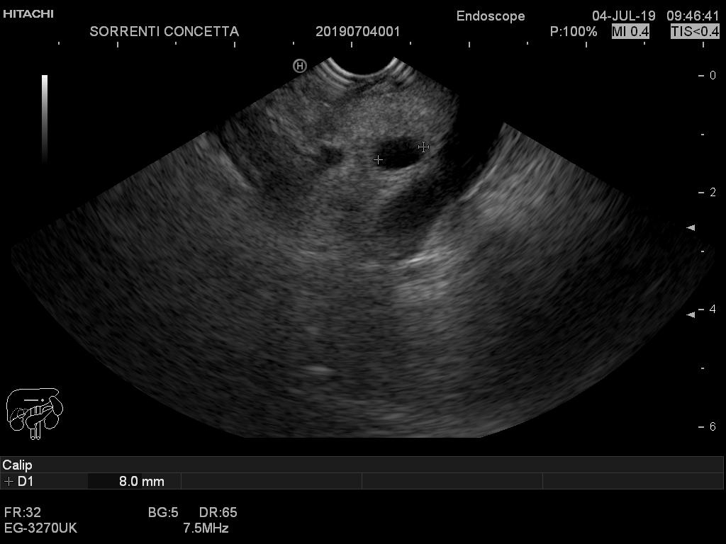

Slide 10
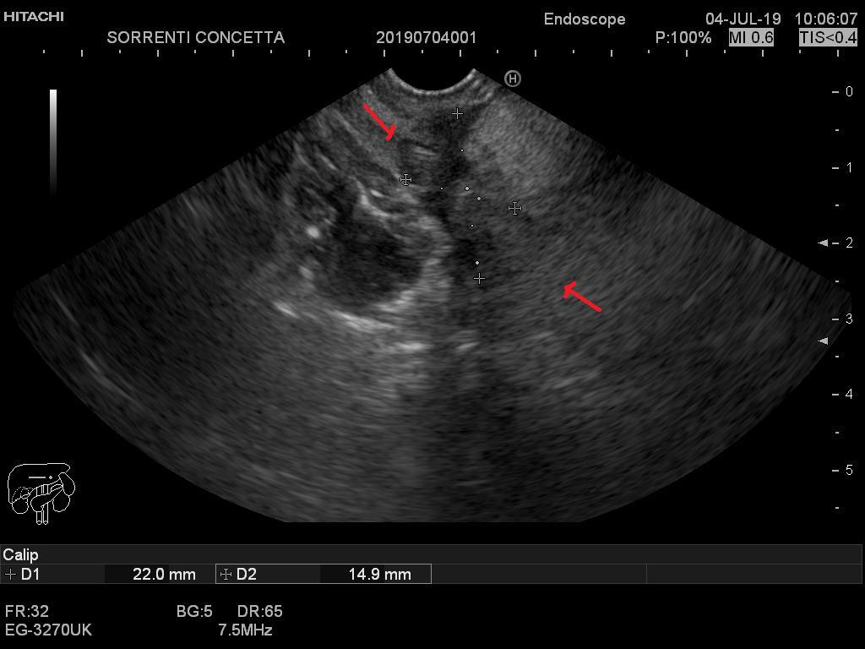

Slide 11
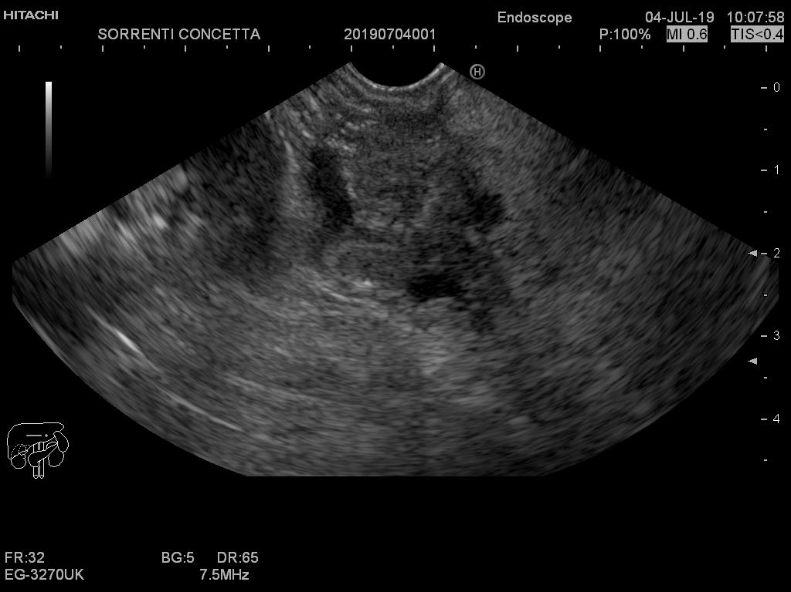

Slide 12
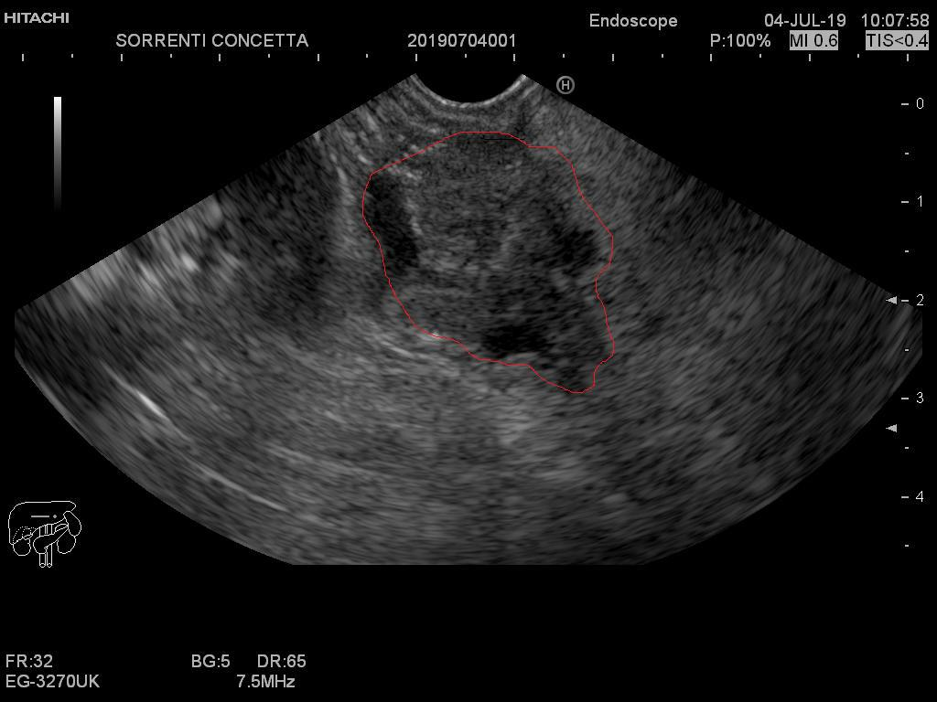

Slide 13
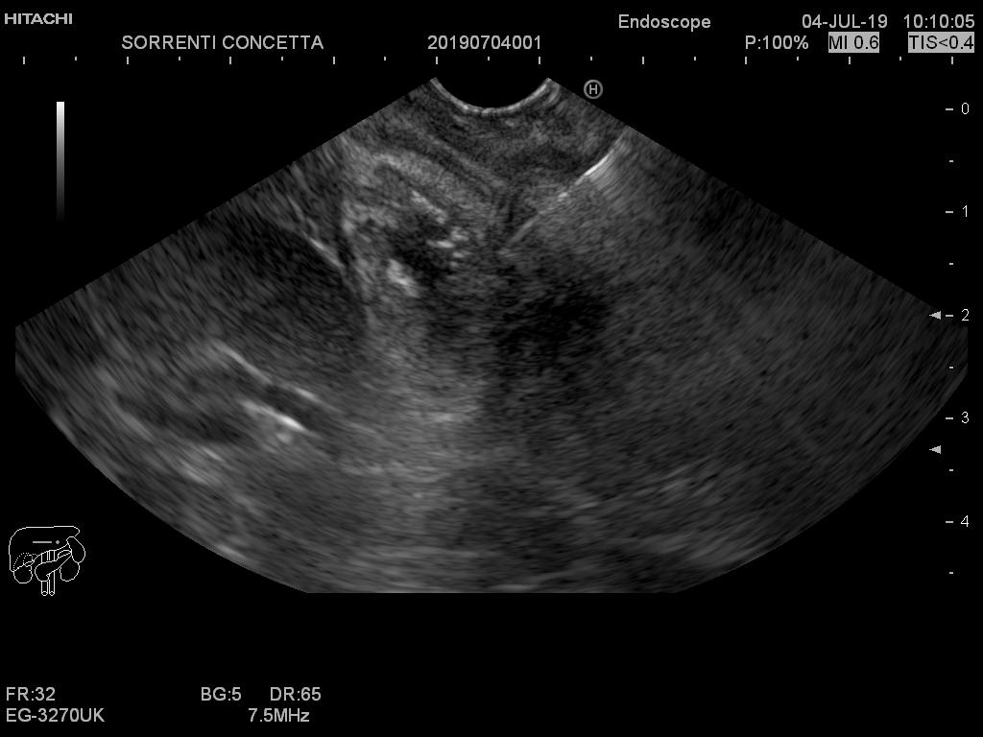

Slide 14
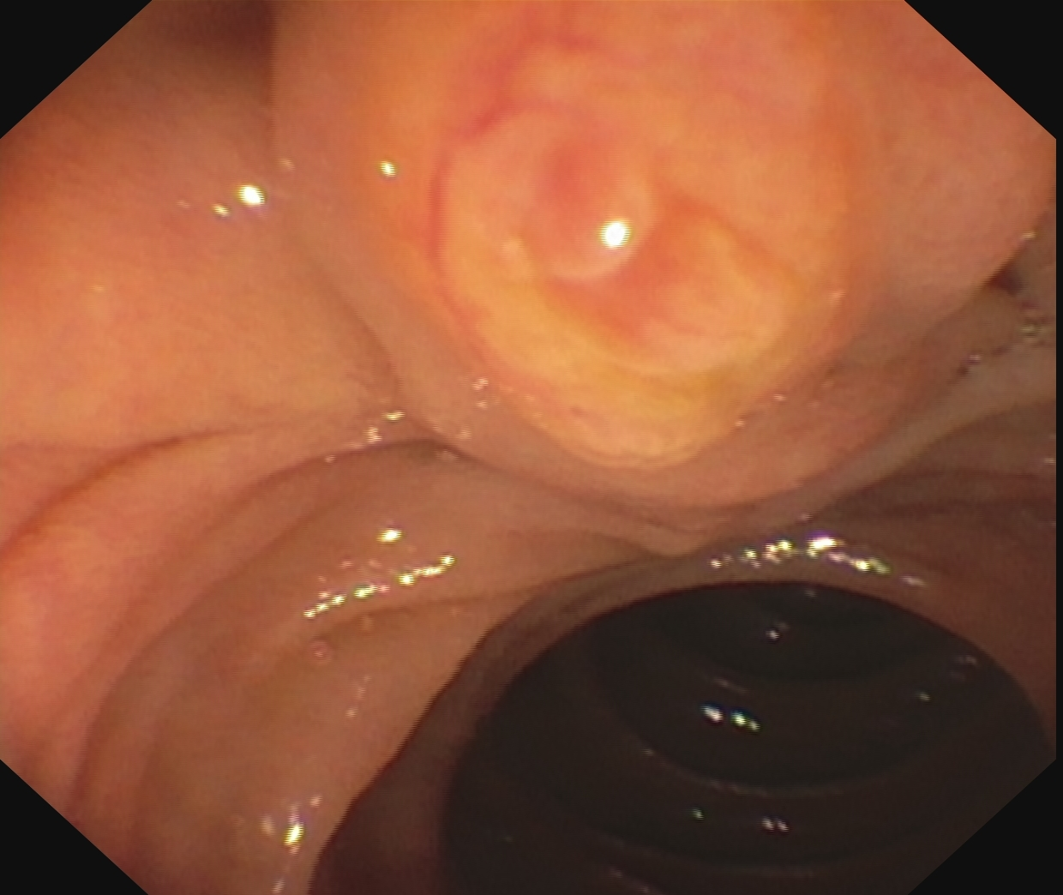
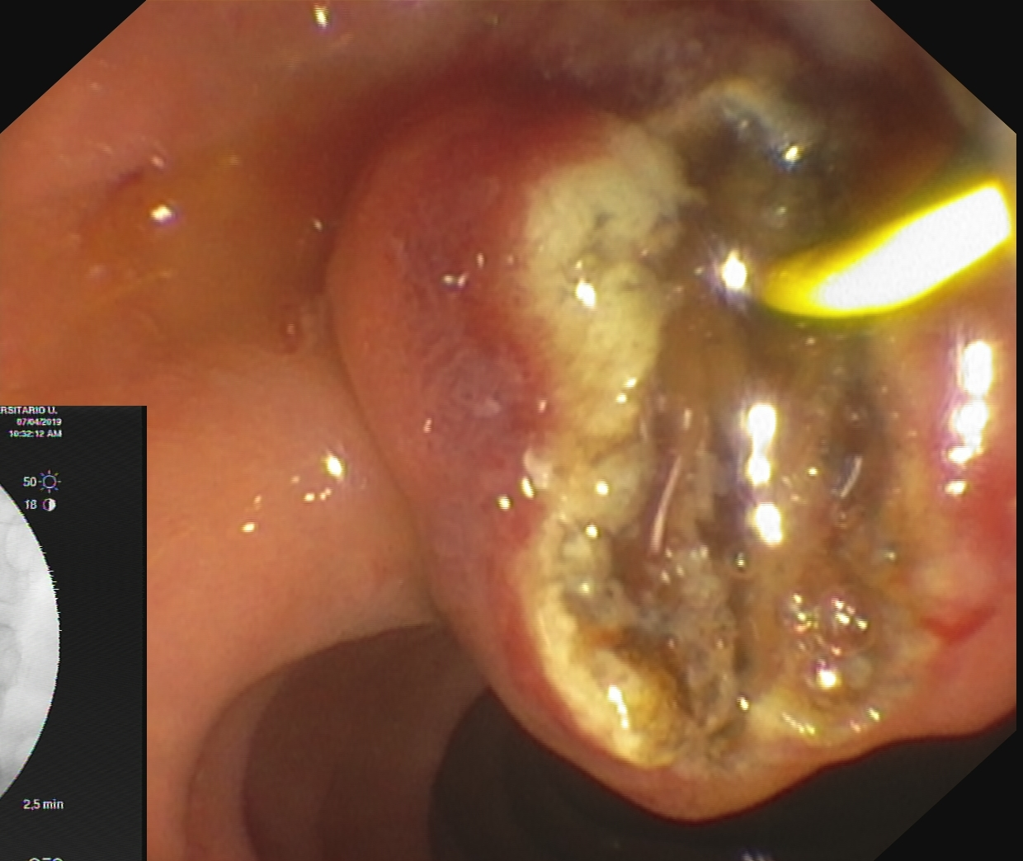
ERCP: alla colangiografia evidenza di stenosi serrata prepapilare,
si effettua sfinterotomia. Si decide si posizionare stent metallico totalmente ricoperto
la cui introduzione risulta difficoltosa a causa della stenosi serrata.
Si esegue dilatazione con catetere da dilatazione 10-12 mm.

Slide 15
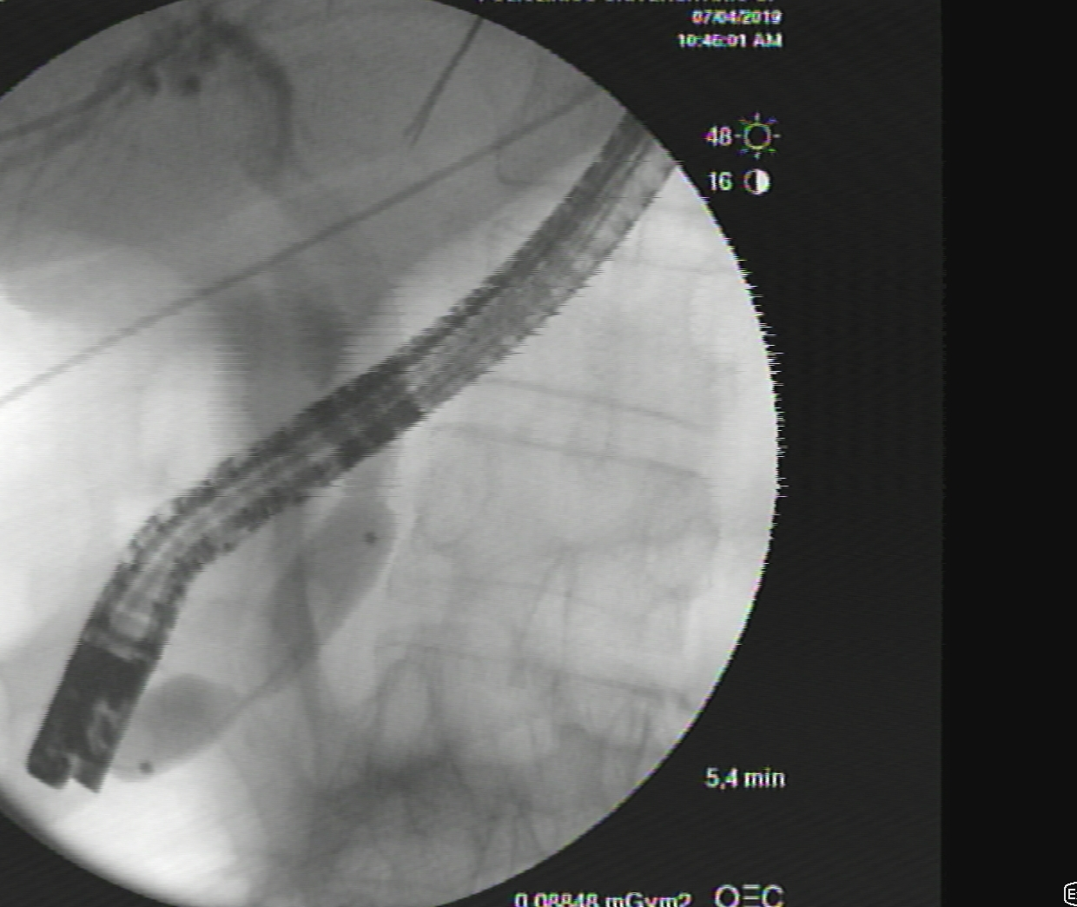

Slide 16
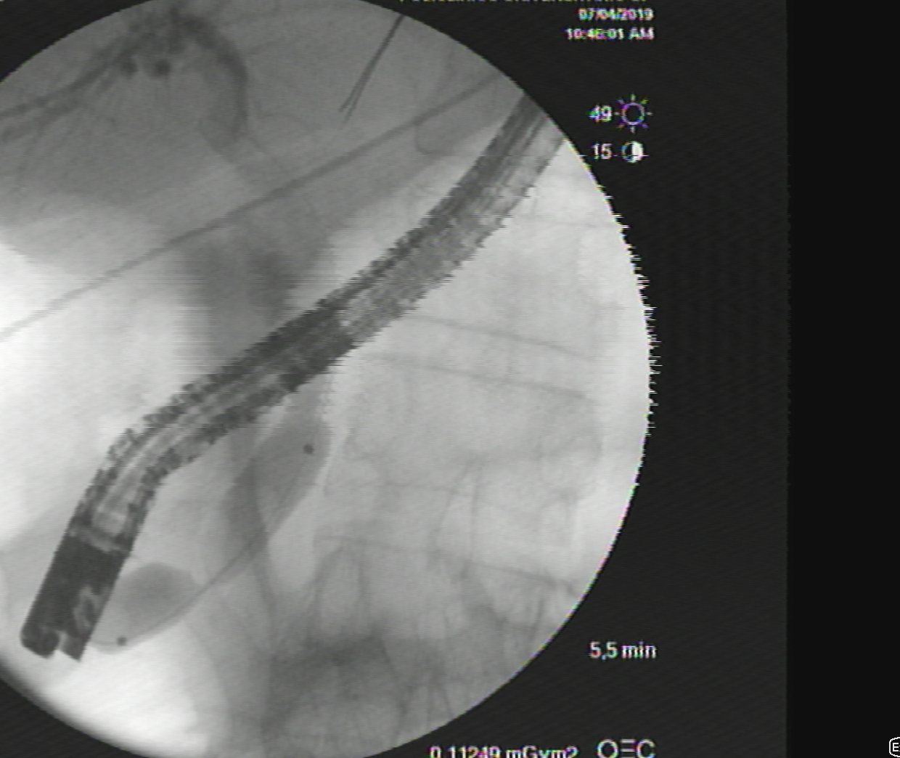

Slide 18
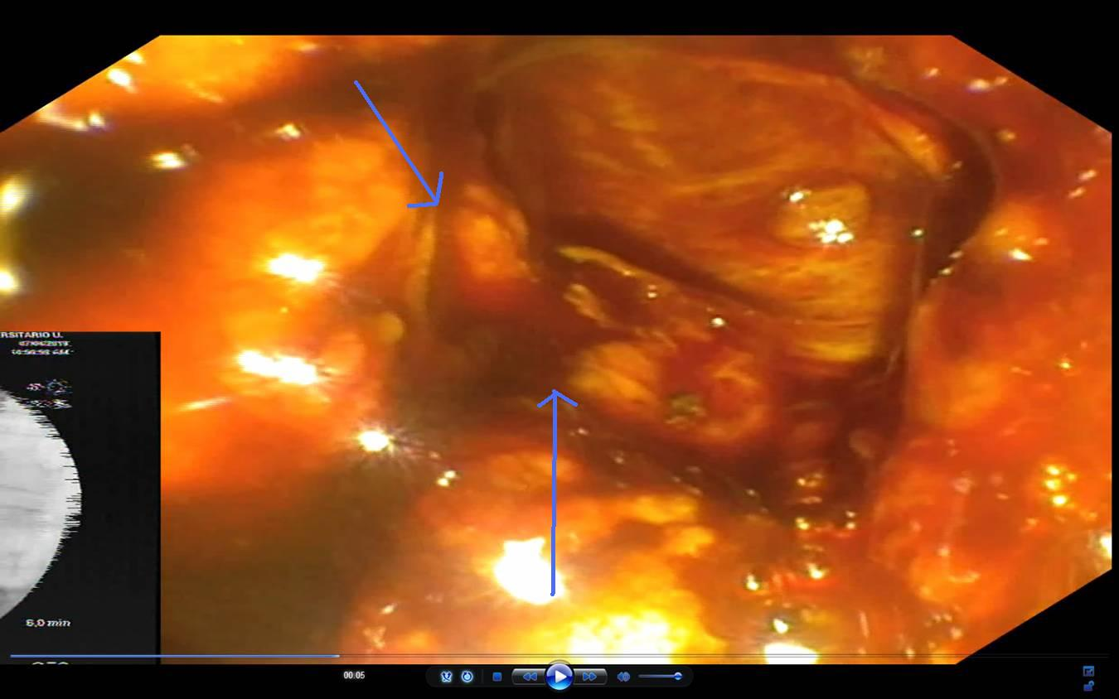

Slide 20
Management of Duodenal Perforation Post-Endoscopic Retrograde Cholangiopancreatography. When and Whom to Operate and What Factors Determine The Outcome? A Review Article
Norman Oneil Machado
Department of Surgery, Sultan Qaboos University Hospital. Muscat, Oman
JOP. J Pancreas (Online) 2012 Jan 10; 13(1):18-25.
Table 1. Literature review (2000 to 2011): demographic details.
ID | Series | No. of cases | Frequency ª (%) | Age (years): mean (range) | Sex (male:female)
#1 | Krishna et al., 2011 [6] | 14 | NR | 46 (11-68) | 8:6
#2 | Morgan et al., 2009 [10] | 24 | 0.2 | 62 (NR) | 9:15
#3 | Avgerinos et al., 2009 [8] | 15 | 0.34 | 69 (34-87) | 6:9
#4 | Mao et al., 2008 [9] | 9 | 0.37 | 58 (36-71) | 3:6
#5 | Knudson et al., 2008 [14] | 32 | 0.6 | 56 (52-60) | 7:25
#6 | Fatima et al., 2007 [13] | 75 | 0.8 | 56 (14-91) | 23:52
#7 | Assalia et al., 2007 [13] | 22 | NR | 63.8 (57-71) | 10:12
#8 | Wu et al., 2006 [11] | 28 | 0.45 | 67 (43-86) | 15:13
#9 | Preetha et al., 2003 [15] | 18 | 0.45 | 72.5 (48-82) | 7:11
#10 | Stapfer et al., 2000 [4] | 14 | 1 | 48.5 (NR) | 4:10
Total | - | 251 | 0.2-1 | 58.5 (11-91) | 93:158 37.1:62.9%
ª Frequency of duodenal perforation per number of ERCP performed

Slide 21
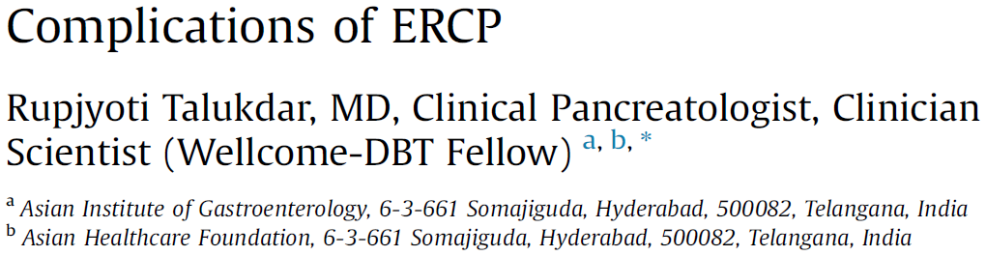
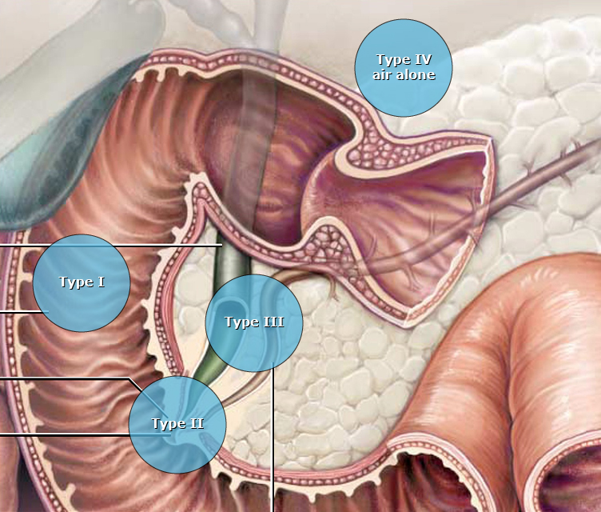
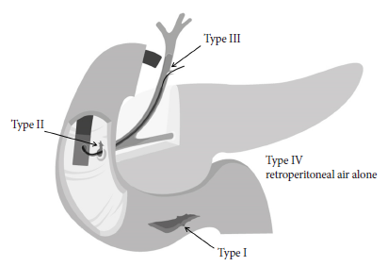

Slide 23
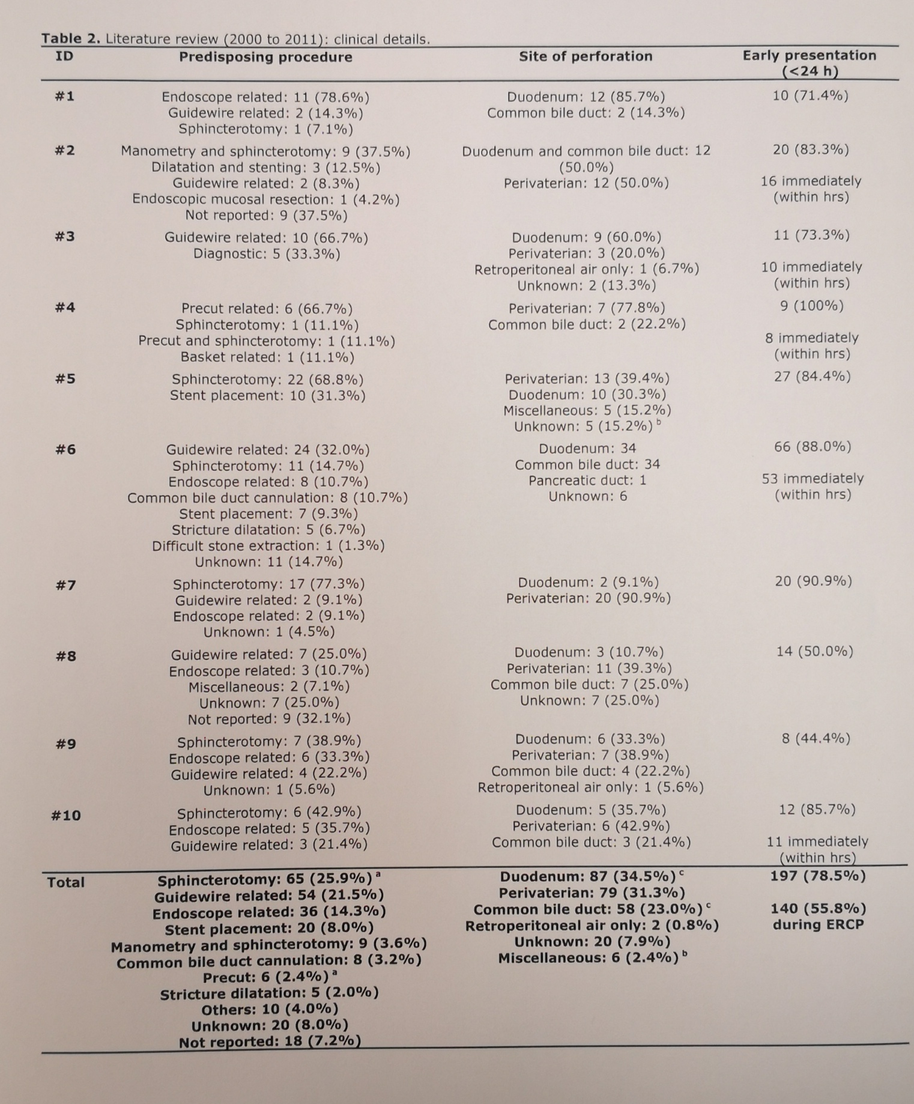
Management of Duodenal Perforation Post-Endoscopic Retrograde Cholangiopancreatography. When and Whom to Operate and What Factors Determine The Outcome? A Review Article
Norman Oneil Machado
Department of Surgery, Sultan Qaboos University Hospital. Muscat, Oman
JOP. J Pancreas (Online) 2012 Jan 10; 13(1):18-25.

Slide 24

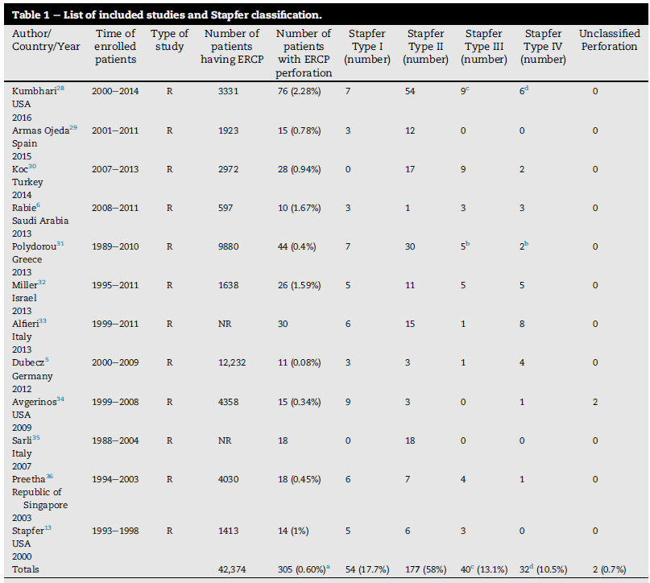


Slide 26
Table 4. Literature review (2000 to 2011): management and outcome.
ID | Conservative management | Surgical management | Surgical procedure | Outcome: mortality
#1 | 7 (50.0%) Percutaneous ultrasound guided drainage: 7 (100%) | 7 (50.0%) | Closure of perforation: 2 T tube insertion: 5 Choledocholithotomy: 4 Duodenal exclusion: 2 Tube duodenostomy: 1 Gastrojejunostomy: 3 Retroperitoneal drainage: 3 | 1 (7.1%)
#2 | 14 (58.3%) | 10 (41.7%) | Closure of perforation / retroperitoneal drainage: 9 Retroperitoneal drainage only: 1 Closure of perforation / retroperitoneal drainage / gastrojejunostomy: 1 | 1 (4.2%)
#3 | 2 (13.3%) | 13 (86.7%) | Closure of perforation / duodenal exclusion / gastrojejunostomy: 12 Closure of perforation / choledochoduodenostomy: 1 Retroperitoneal drainage: 1 | 3 (20.0%)
#4 | 6 (66.7%) | 3 (33.3%) | Retroperitoneal drainage: 3 T tube insertion: 2 | 0
#5 | 20 (62.5%) | 12 (37.5%) | Closure of perforation: 3 Retroperitoneal drainage: 5 T tube insertion: 2 Duodenal exclusion: 1 Tube duodenostomy: 1 | 0
#6 | 53 (70.7%) Salvage surgery: 4 (7.5%) | 22 (29.3%) | Closure of perforation: 12 Retroperitoneal drainage: 7 Choledochojejunostomy / biliary reconstruction: 3 | 5 (6.7%)
#7 | 20 (90.9%) Salvage surgery: 2 (10.0%) | 4 (18.2%) | Closure of perforation: 3 T tube insertion: 2 Retroperitoneal drainage: 2 Choledochojejunostomy / biliary reconstruction: 2 | 1 (4.5%)
#8 | 18 (64.3%) | 10 (35.7%) | Closure of perforation: 2 Retroperitoneal drainage: 6 T tube insertion: 3 | 4 (14.3%)
#9 | 8 (44.4%) | 10 (55.6%) | Closure of perforation: 5 Duodenal exclusion: 5 | 3 (16.7%)
#10 | 8 (57.1%) Salvage surgery: 3 (37.5%) | 9 (64.3%) | Duodenal exclusion / gastrojejunostomy / retroperitoneal drainage: 4 Choledocholithotomy / T tube insertion: 3 Duodenogastrectomy: 1 | 2 (14.3%)
Total | 156 (62.2%) Salvage surgery: 9 (5.8%) | 100 (39.8%) Included salvage surgery | Closure of perforation: 49 (49.0%) Retroperitoneal drainage: 39 (39.0%) Duodenal exclusion: 24 (24.0%) T tube insertion: 13 (13.0%)

Slide 28
Management of Duodenal Perforation Post-Endoscopic Retrograde Cholangiopancreatography. When and Whom to Operate and What Factors Determine The Outcome? A Review Article
Norman Oneil Machado
Department of Surgery, Sultan Qaboos University Hospital. Muscat, Oman
JOP. J Pancreas (Online) 2012 Jan 10; 13(1):18-25.
Table 3. Literature review (2000 to 2011): investigations.
ID | Abdomen X-ray | Abdomen US | CT scan | Contrast study | During ERCP ª
#1 | 3 (21.4%) | 12 (85.7%) | 11 (78.6%) | 3 (21.4%) | 0
#2 | 1 (4.2%) | NR | 6 (25.0%) | 0 | 16 (66.7%)
#3 | 1 (6.7%) | 0 | 11 (73.3%) | 0 | 4 (26.7%)
#4 | 8 (88.9%) | 0 | 8 (88.9%) | 0 | 8 (88.9%)
#5 | 10 (31.3%) | 0 | 11 (34.4%) | 0 | 11 (34.4%)
#6 | 10 (13.3%) | 0 | 27 (36.0%) | 19 (25.3%) | 26 (34.7%)
#7 | 13 (59.1%) | 0 | 19 (86.4%) | 8 (36.4%) | 2 (9.1%)
#8 | 6 (21.4%) | 0 | 9 (32.1%) | 7 (25.0%) | 8 (28.6%)
#9 | 3 (16.7%) | 0 | 10 (55.6%) | 2 (11.1%) | 5 (27.8%)
#10 | 3 (21.4%) | 0 | 0 | 4 (28.6%) | 11 (78.6%)
Total | 58 (23.1%) | 12 (4.8%) | 112 (44.6%) | 41 (17.1%) | 89 (36.3%)
ª Detection of duodenal perforation at the time of ERCP
NR: not reported

Slide 29
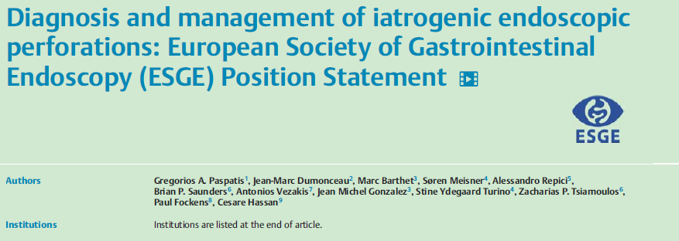
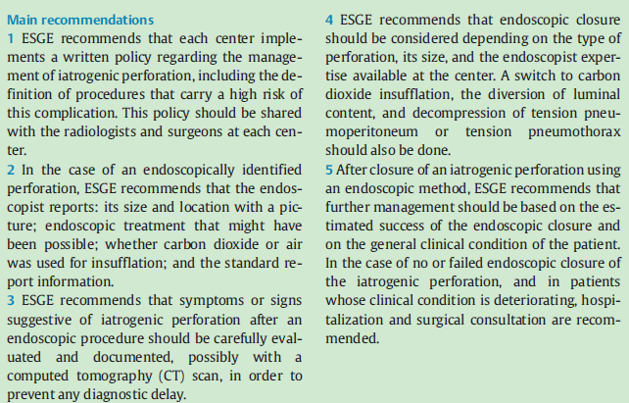

Slide 30

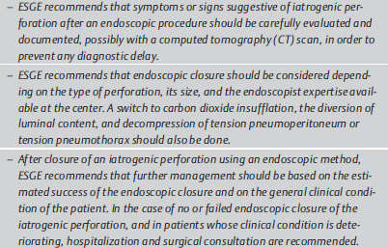
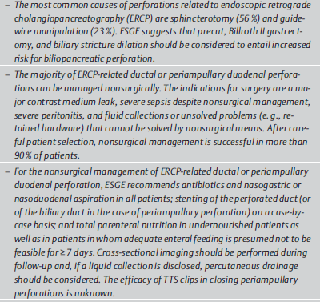
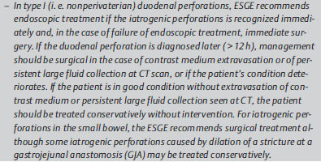

Slide 31
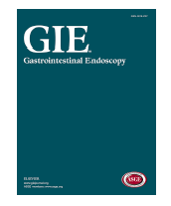
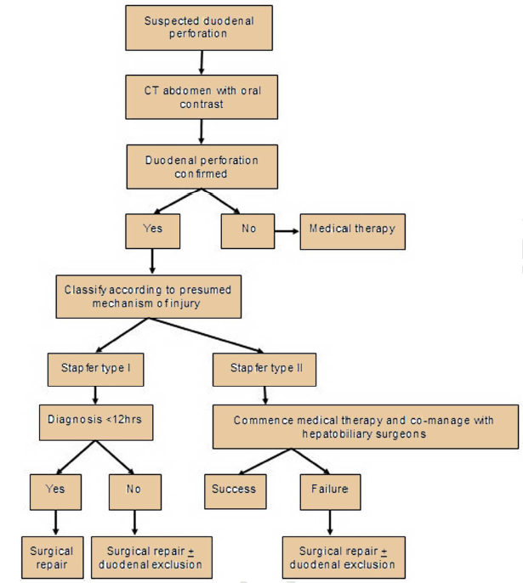
Gastrointest Endosc. 2016 May;83(5):934-43. .
Kumbhari V1, Sinha A1, Reddy A1, Afghani E1, Cotsalas D1, Patel YA1, Storm AC1, Khashab MA1, Kalloo AN1, Singh VK1.

Slide 32
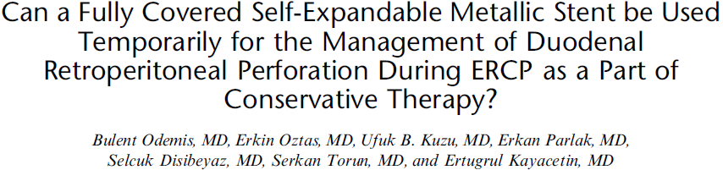
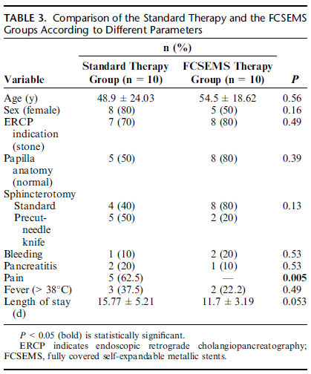

Slide 33
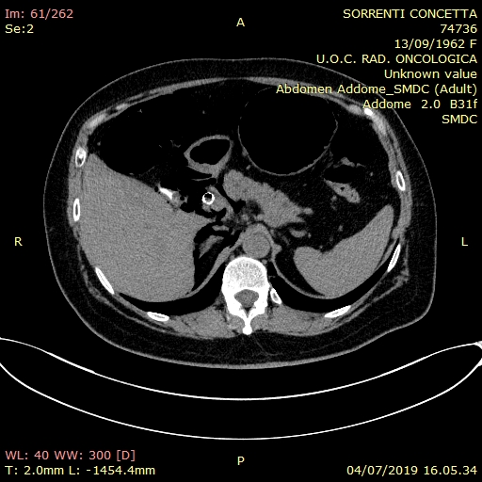
Caso clinico
TC TEMPO 0

Slide 34
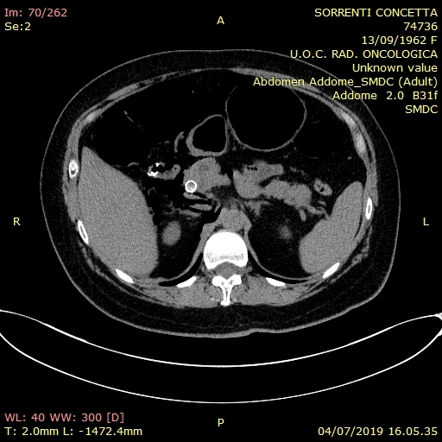
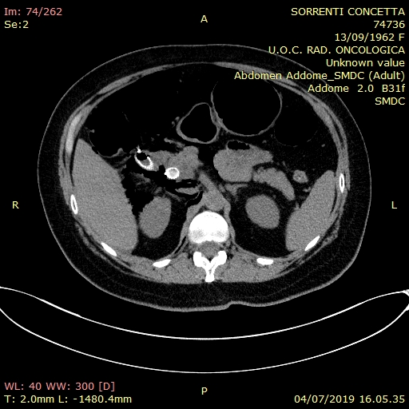
Caso clinico
TC TEMPO 0

Slide 35
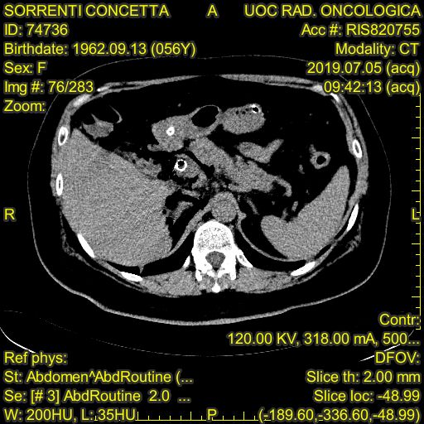
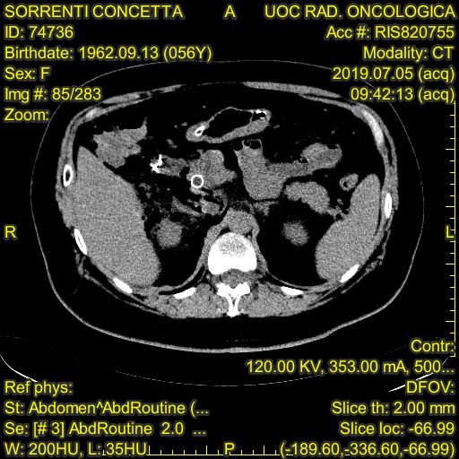
Caso clinico
TC TEMPO 1 (A 24 ORE)

Slide 36
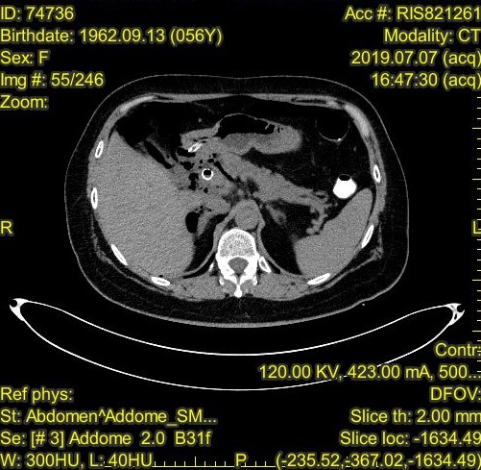
Caso clinico
TC TEMPO 2 (A 72 ORE)

Slide 37
Caso clinico
Paziente dimessa in 9° giornata in assenza di sintomatologia dolorosa,
In condizioni di normalizzazione degli indici di colestasi e con riduzione degli indici di flogosi (il giorno delle procedura 12.000 GB, PCR:34).
Durate la degenza : standard terapy
posizionamanto di SNG o SND
Trattamento antibiotico (cefalosporine di terza generazione)
PPI
NPT ( inizio nutrizione enterale in 5° giornata)
Antidolorifico in caso di necessità (non necessario)
Controllo dei parametri vitali (sempre nella norma)
Controllo “full biochemistry panel “ (in riduzione compresi lattati e procalcitonina)
Controllo con TC (0-1-2-3)
Consulto chirurgico

Slide 38
