Slide 1

Complicanze in endoscopia digestiva
formazione, qualità e percorsi
Pier Alberto Testoni
Università Vita Salute San Raffaele
Milano

Slide 2
Transoral therapeutic endoscopy - Endolumenal surgery
Resection / ablation of mucosal lesions
Submucosal space therapeutic endoscopy
Full thickness resection
Trans-oral treatment of motor functional disorders
Trans-oral treatment of gastro-esophageal reflux disease
Trans-oral treatment of obesity
Therapeutic ERCP
Trans-oral EUS-guided interventions

Slide 3
Efficacy of endoscopic resection of large benign colorectal neoplasia
50 studies included in the meta-analysis; 6,442 patients
Endoscopic resection: Successful in 90.3% of cases
Complication rate 8.0% Mortality rate 0.08%
Recurrence rate 13.8% Invasive cancer 0.3%
Surgical resection:
Adverse events 17%- 30% (2-fold increase compared to endoscopic resection)
Mortality rate 1% - 1.6% (10-fold increase compared to endoscopic resection)
Cost of colorectal polyp treatment:
endoscopic resection = $ 5,570 per patient
surgical resection = $ 18,717 per patient
Endoscopic resection is a cost-effective strategy for removal of colorectal neoplasia.
The effectiveness depends on the high technical success, low adverse event rates, and better quality of life
Hassan C, et al. Efficacy and safety of endoscopic resection of large colorectal polyps: a systematic review and meta-analysis. Gut 2016; 65: 806-820

Slide 4
Age , yrs | 50 | 80
Cost of surveillance colonoscopy | $ 722 | $ 1,500
Cost of LR of polyp | $ 17,260 | $ 20,000
Cost of surgical intervention for complication | $ 27,364 | $ 35,000
Cost of colonoscopic resection of large colon polyp | $ 1,381 | $ 2,500
Loss of utility, for colonoscopy (2 days) | .0055 | .0082
Loss of utility, for LR (6.5 days) | .0178 | .0274
Loss of utility, for surgical intervention for adverse events (9.9 days) | .0271 | .0384
Overall costs of surgical vs endoscopic resection of large colorectal polyps
All cost data derived from Centers for Medicare & Medicaid Services reimbursement and mean cost for respective CPT codes in 2012-2013.
All loss of utility data derived from 2012 Healthcare Cost and Utilization Project data using a national inpatient sample for all patients admitted with respective CPT codes
Law R et al. Gastrointest Endosc 2016; 83:1248-57

Slide 5
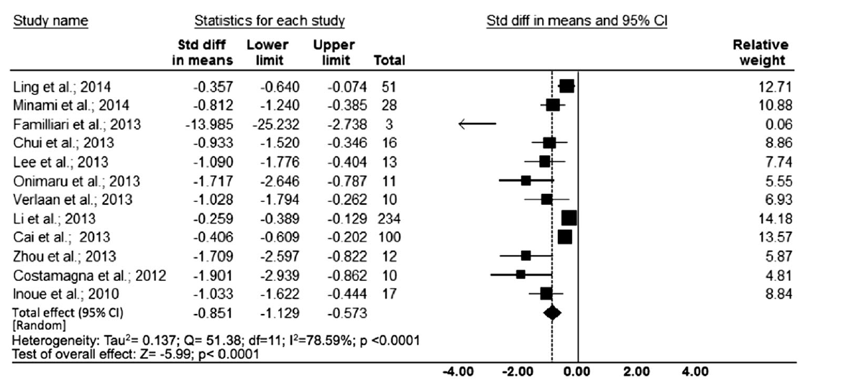
Esophageal POEM outcomes: efficacy
Talukdar R, Inoue H, Reddy N. Surg Endosc 2014

Slide 6
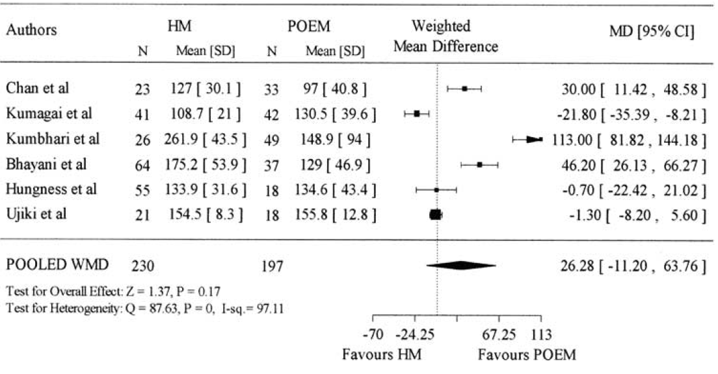
Operative time of esophageal POEM vs Laparoscopic Heller Myotomy (LHM) for Achalasia : Meta-analysis
Awaiz et al. Surg Laparosc Endosc Percutan Tech 2017

Slide 7
Trans-oral treatment of obesity
Space occupying devices
Balloon:
- Orbera
- Obalon
- Reshape balloon
- Spatz
Non balloon:
- Trans-pyloric shuttle
Gastric restriction
Sleeve gastroplasty
- Apollo Overstich
- GERDX
- Endolumina
- Primary obesity surgery
endoluminal (POSE)
Malabsorption
Gastrointestinal by pass sleeve
- Endobarrier
EUS-guided magnetic by pass
Duodenal resurfacing
Aspiration
- AspireAssist
Weight reduction
Type 2 diabetes control

Slide 8
How to prevent and manage complications of endoscopy ?
adequate training / experience
- learning curve
- case volume (longlife / per year)
- simulators
- retraining
adequate technology / facilities
- imaging
- devices
- endoscopy room
adequate reprocessing
adequate supporting team

Slide 9
Skills currently required for endoscopy practice
Learning to perform an endoscopic procedure or technique requires acquisition of:
- cognitive (knowledge and recognition) skills
- technical (psychomotor) skills
- non-technical (expertise and behavior) skills
An explicit understanding of the competencies required for performance of high-quality endoscopic procedures and techniques is essential to the development of a framework for endoscopy training and assessment.
Cognitive and non-technical skills often are underemphasized early in the training process, although these are critically important attributes of a competent endoscopist.
Governing Board of the American Society for Gastrointestinal Endoscopy (ASGE)
Gastrointest Endosc 2019;90:13-26

Slide 10
Skills currently required for endoscopy practice
Cognitive skills encompass knowledge and the application of endoscopically derived information to clinical practice
Technical skills are the psychomotor activities required to carry out a procedure
Non-technical skills include core skills decision making that
“allow individuals to integrate their knowledge and technical expertise to function effectively within a healthcare team, adapt to varied contexts, tolerate uncertainty, and ultimately provide safe and effective patient care”
Non-technical skills also include safety-related competencies such as knowing when not to proceed, when to call for help, and crisis management skills
Governing Board of the American Society for Gastrointestinal Endoscopy (ASGE)
Gastrointest Endosc 2019;90:13-26

Slide 11
Non-technical skills
Non-technical skills are an essential component of competent endoscopic practice and a key contributor to patient safety and clinical outcomes
Procedure-related adverse events are more likely to stem from behavioral failures, such as a communication error, as opposed to a lack of technical skill
The vast majority of recommendations originating from the 2004 investigation into deaths occurring within 30 days of adult therapeutic endoscopy procedures in the United Kingdom, underscored deficits in non-technical skills, such as situation awareness, rather than technical
Hitchins CR, Ward C, Edworthy J, et al. Non-technical skills and gastrointestinal endoscopy: a review of the literature.
Frontline Gastroenterol 2018;9:129-34

Slide 12
Definition of competence levels
Efficiency:
The point in the learning curve in which the operator starts engaging in performance refinements that lead to increase in technical goals and decrease in procedure time and complications
Mastery:
The point in the learning curve at which procedure time becomes consistent, and no further improvement is expected
Competency / Proficiency:
The understanding the cognitive aspects of procedures and reliably achieving the procedure-related technical goals

Slide 13
Endoscopy 2017; 49: 270–297

Slide 14
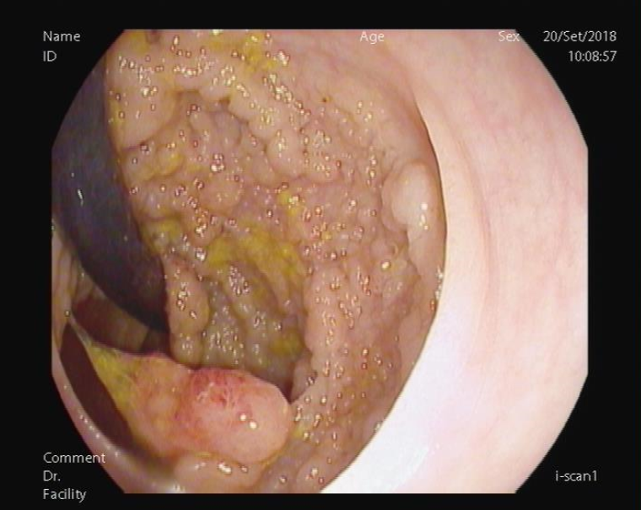
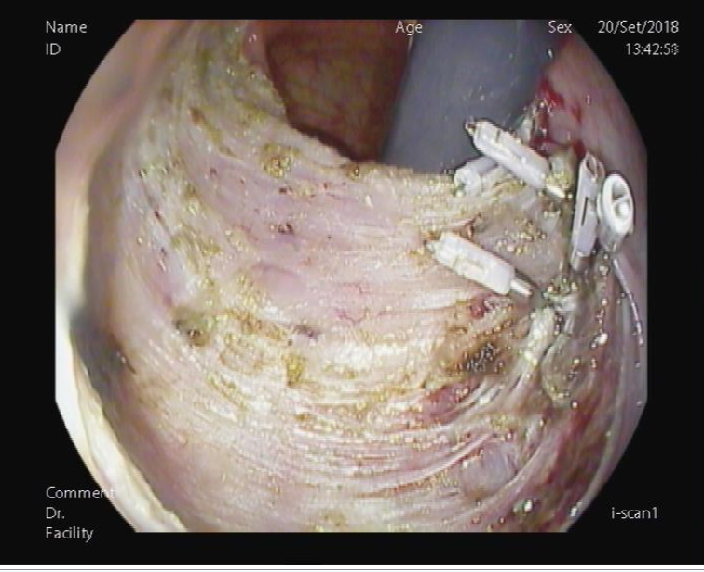
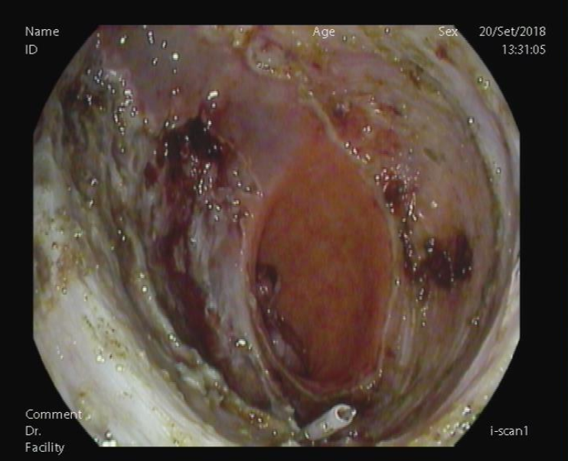
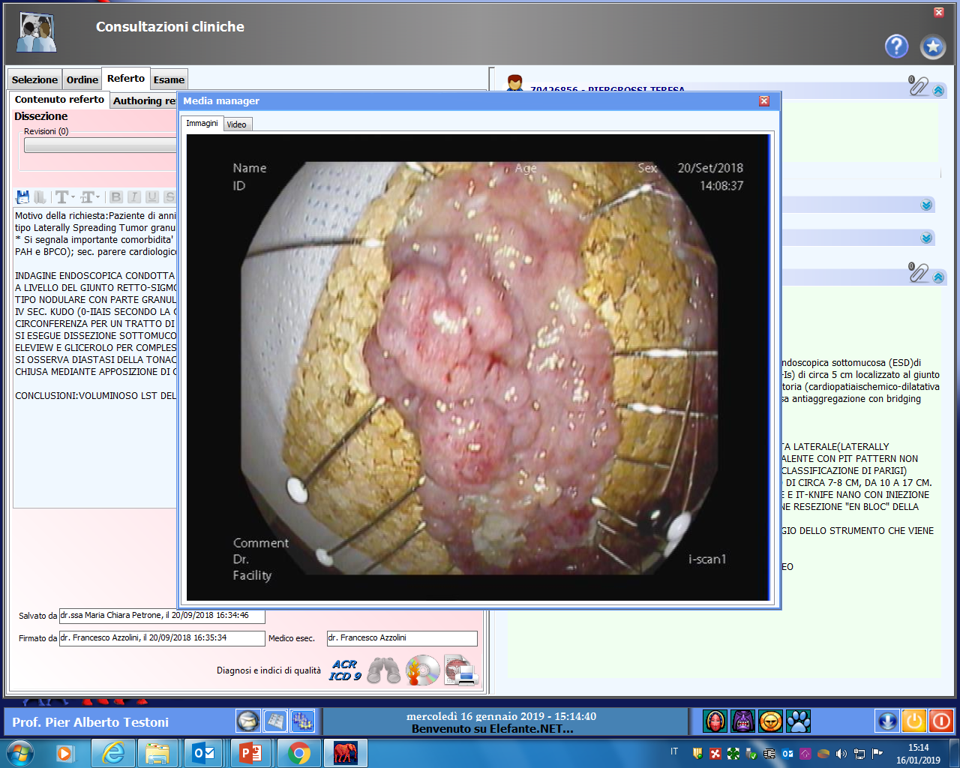
Endoscopic submucosal dissection of lateral spreading tumor of the colon

Slide 15
ESGE discourages the starting of initial ESD training in humans. Practice on animal and/or ex vivo models is useful to gain the basic ESD skills. Beginning human practice in the colon is not recommended.
At least 20 ESD procedures in these models before human practice, with the goal of at least eight en bloc complete resections in the last 10 training cases, with no perforation.
Endoscopy, 2019

Slide 16
Performance of ESD in humans should start on lesions < 30mm, located in the antrum or in the rectum for the first 20 procedures, in tertiary referral centers.
The first 10 human ESD procedures should be done under the supervision of an ESD-proficient endoscopist.
In order to maintain proficiency in ESD, ESGE recommends a minimum case load of 25 ESD procedures per year
En bloc resection rates should be above 90 %, and the perforation rate should be below 3%, with a lower than 1% need for surgery because of complications.
Endoscopy, 2019

Slide 17
Endoscopists performing ESD should:
have specific knowledge of the instrumentation, technique, and
electrosurgical equipment
be able to correctly estimate the probability of performing a curative resection based on the characteristics of the lesion and
know the benefit/risk relationship of ESD when compared with other therapeutic alternatives
know how to interpret the istopathology findings of the ESD specimen:
criteria for low risk resection (“curative”), local risk resection, and high
risk resection (“non-curative”), as well as their implications
ESD should be performed only in a setting where early and delayed complications can be managed adequately
Non-technical skills
Endoscopy, 2019

Slide 18
In presence of large lesions, routine piecemeal EMR and selective ESD are cost effective approach compared to routine ESD
Gut, 2018; 67: 1965-1973

Slide 19
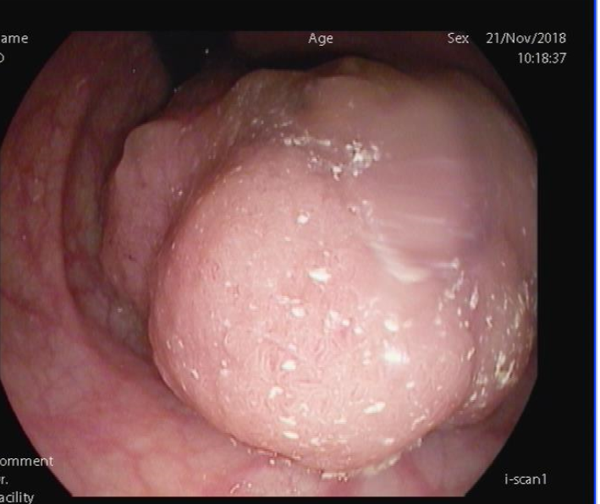
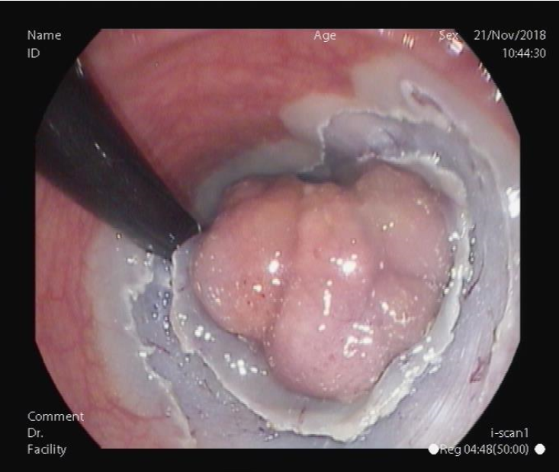
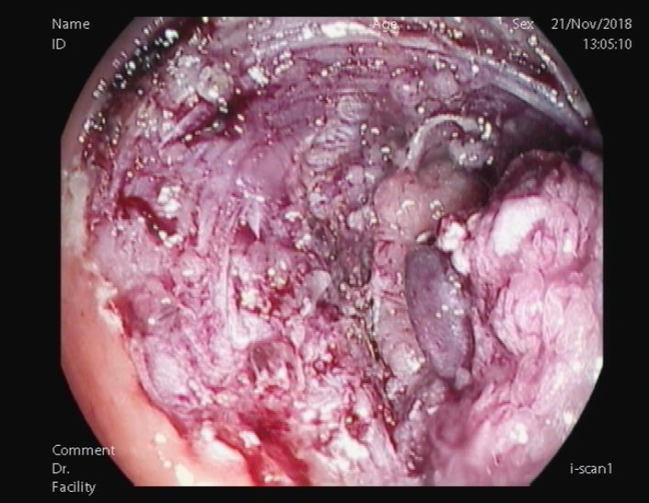
Endoscopic resection: hybrid ESD

Slide 20
Endoscopic submucosal dissection: Orise (Boston Inc.)
Lesion in the rectum and distal sigmoid colon > 5 cm in size
Stabilizes the device on the lesion
Permits triangulation
Facilitates submucosal dissection
Reduces time of resection

Slide 21
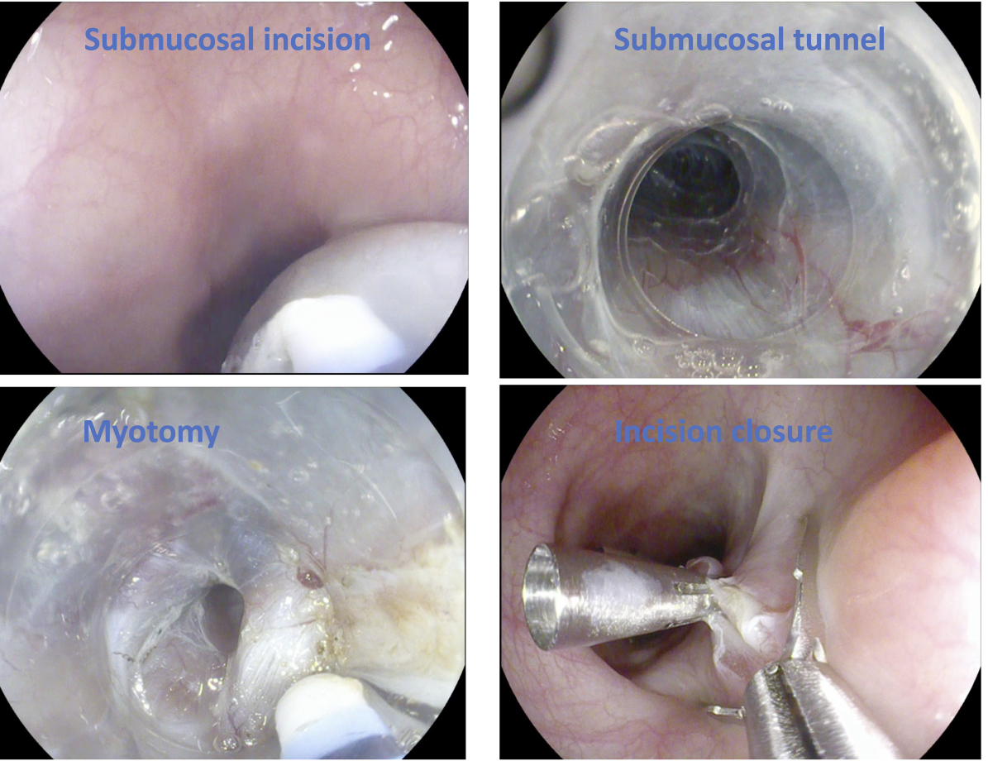
The third space
A new concept to approach submucosal lesion and full thickness resection maintaining the integrity of the mucosa
“The third space”

Slide 22
Third space endoscopy
Submucosal Tunneling endoscopic resection of Submucosal Tumors (STER)
Submucosal Tunneling Mucosal Dissection (ST-ESD)
Esophageal Peroral Endoscopic myotomy (E-POEM)
Gastric Peroral Endoscopic pyloromyotomy (G-POEM)
Submucosa Tunneling septotomy for Zenker and epiphrenic diverticula (D-POEM)
Per-rectal Endoscopic Myotomy (PREM)
Trans-rectal/Trans-gastric endoscopic cholecystolitotomy

Slide 23
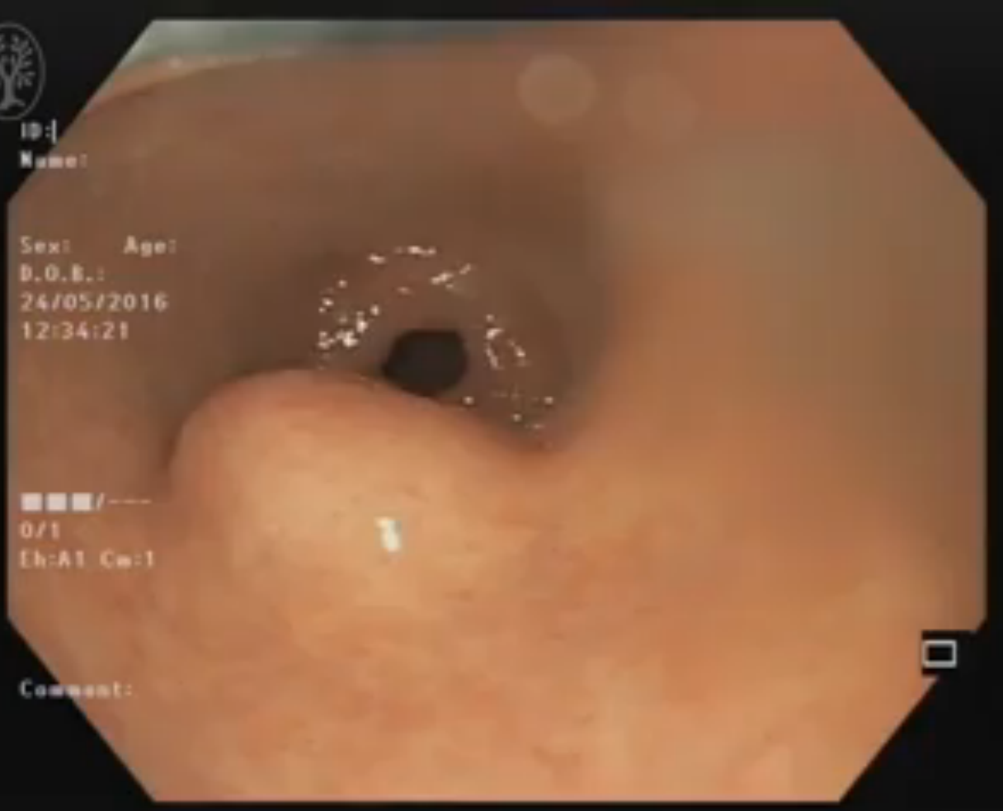
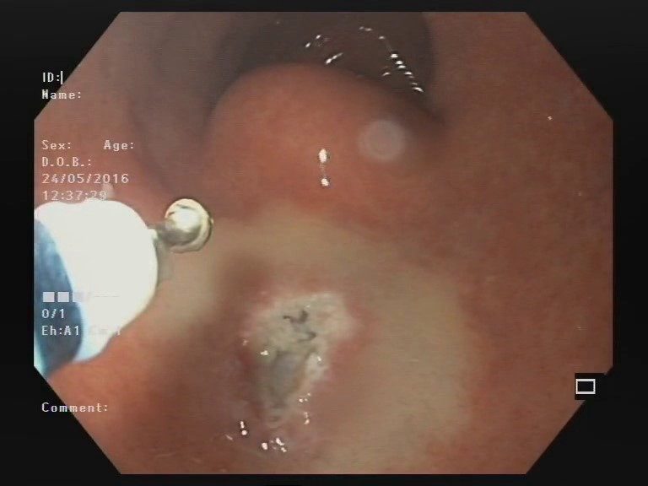
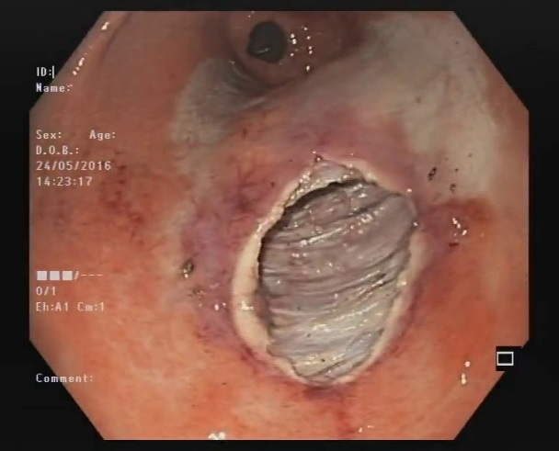
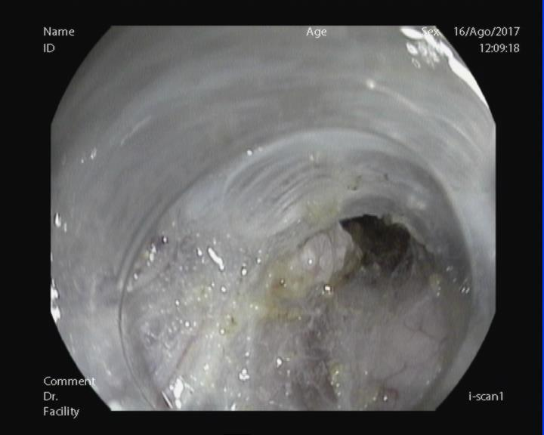
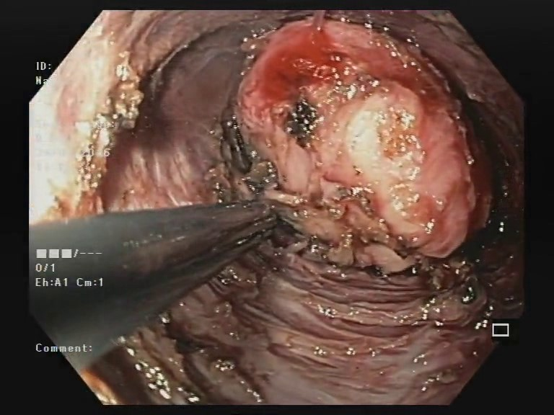
Tunneling technique for full thickness resection of large gastric GIST

Slide 24
Esophageal POEM: tunneling technique

Slide 25
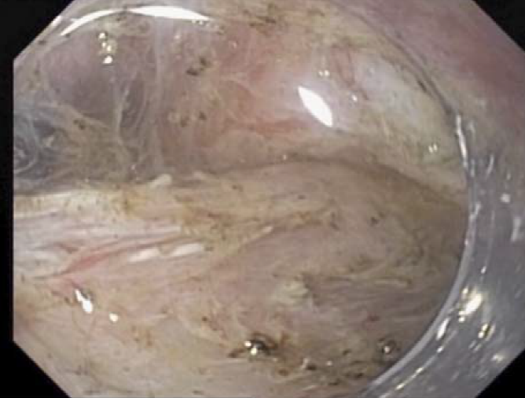
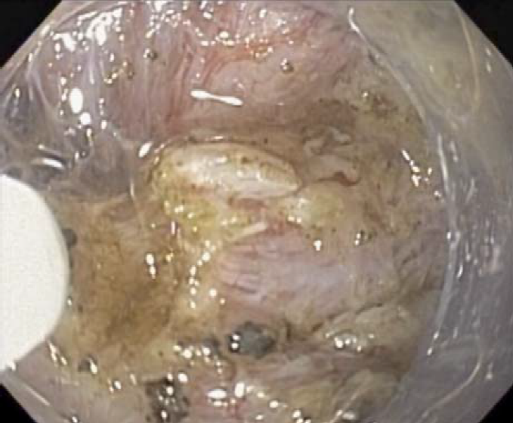
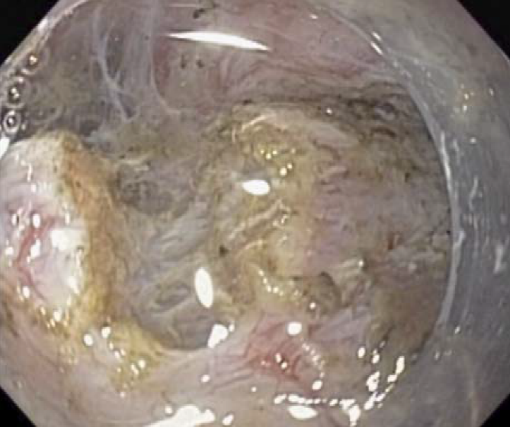
Gastric POEM: tunneling technique and muscle section

Slide 26
Gastrointest Endosc 2013;77:719-25
Consecutive procedures: line demonstrates the trend of decreasing length of procedure (LOP).
Consecutive procedures: each dot defines the number of mucosotomies per case along the timeline of experience.
Mastery of operative technique in POEM is evidenced by a decrease in length of procedure, variability of minutes per centimeter of myotomy, and incidence of inadvertent mucosotomies and plateaus in about 20 cases for experienced endoscopists.

Slide 27
Gastrointest Endosc 2015;81:1181-7
Sequential grouping of procedure time. Median (interquartile range) procedure times (minutes) for each sequential group showing overall decrease in procedure time.
Plots of procedure time with a locally weighted scatter plot smoothing regression curve. CUSUM analysis showing efficiency after 40 procedures and mastery after 60 procedures

Slide 28
Endoscopy International Open 2015; 03: E559–E565
Control chart of speed behavior in subsequent procedures of ex vivo model
Control chart of speed behavior in subsequent procedures of porcine model

Slide 29
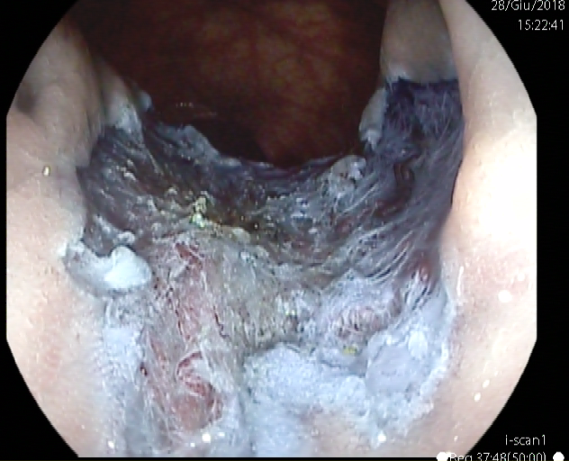
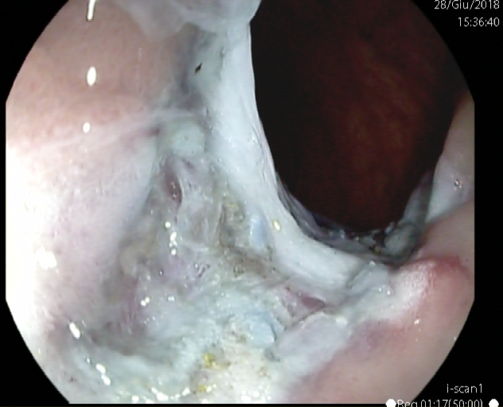
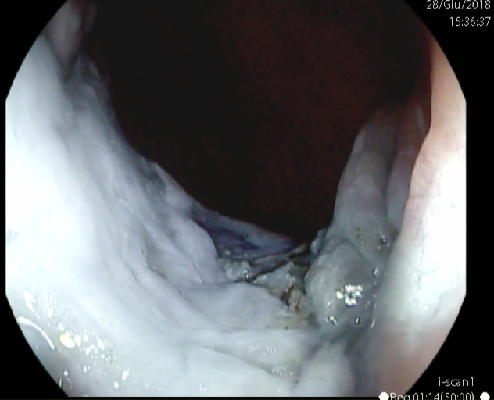
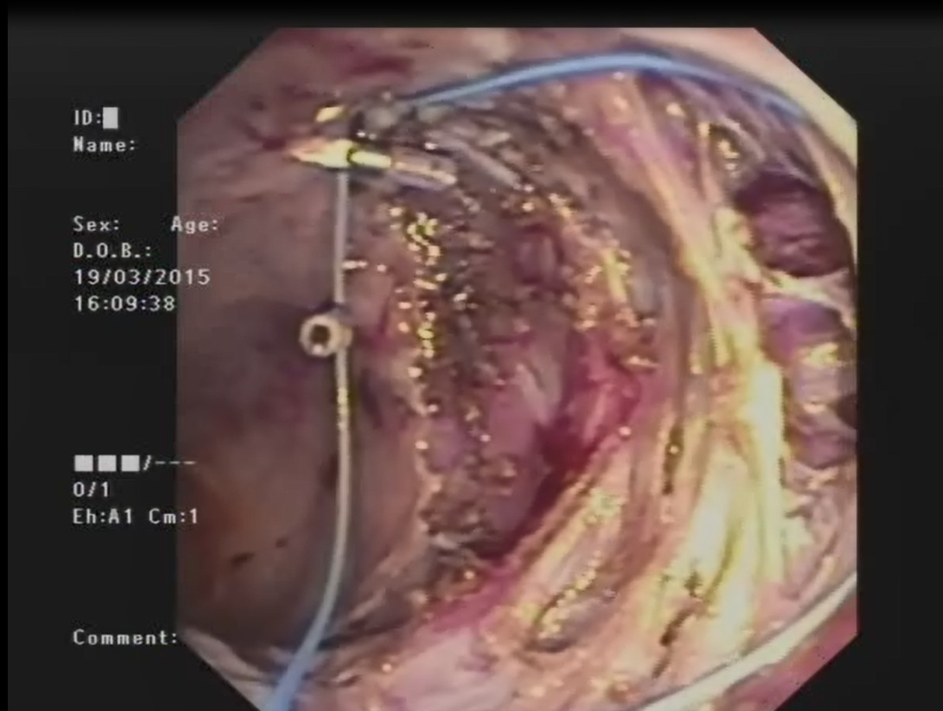
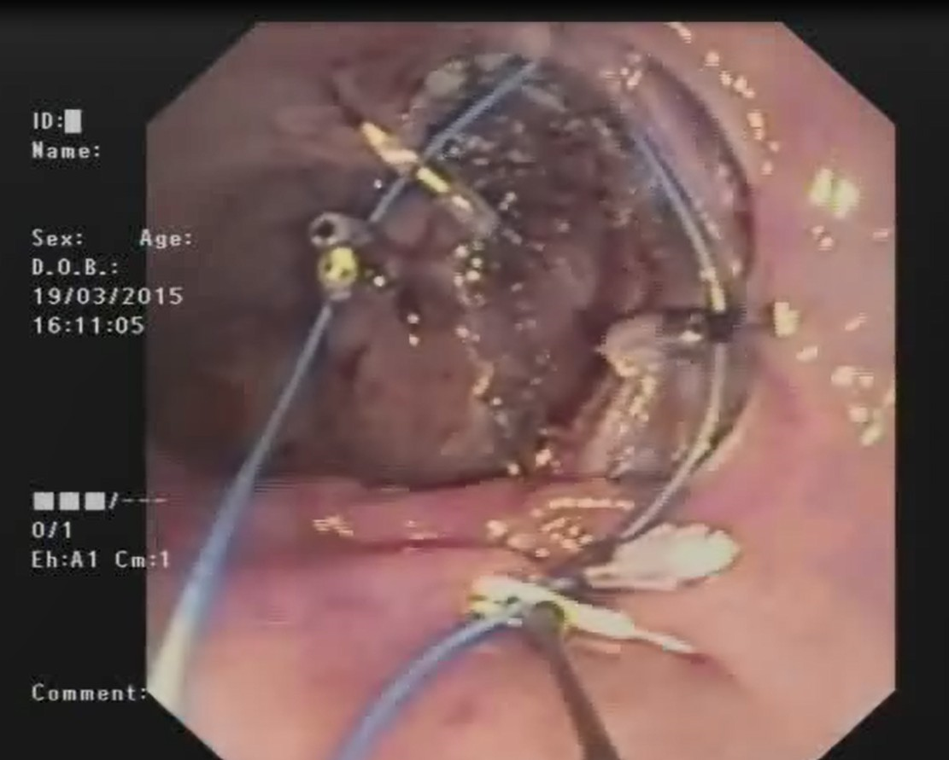
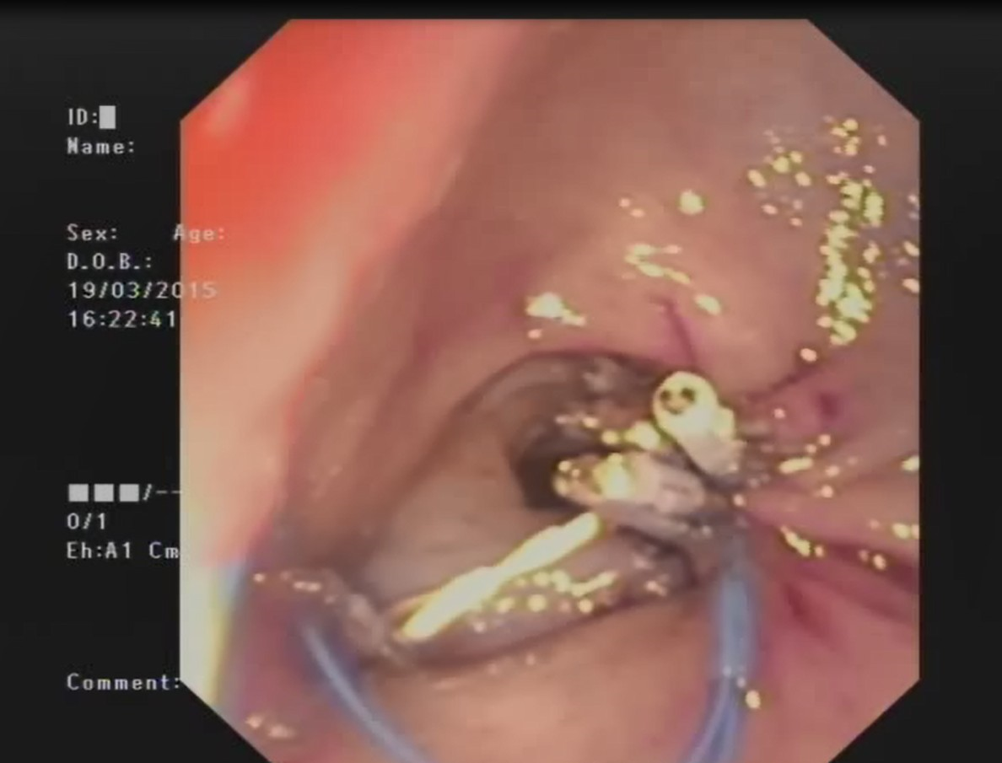
ESD should be performed only in a setting where early and delayed complications can be managed adequately
Closure of mucosal defect by Purastat
Closure of mucosal defect by multiple clips on endoloop

Slide 30
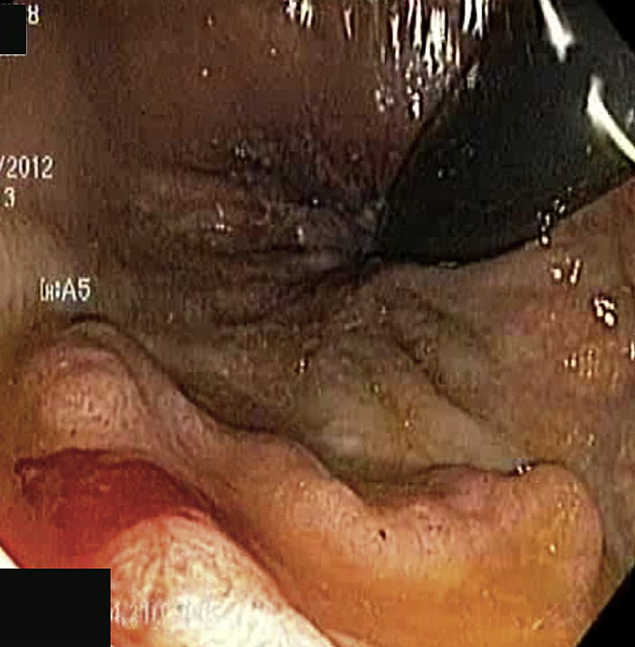
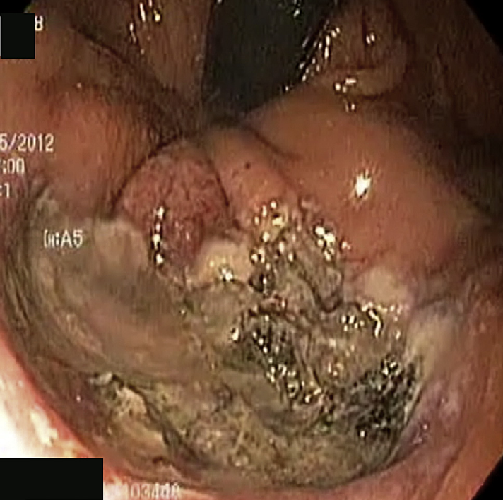
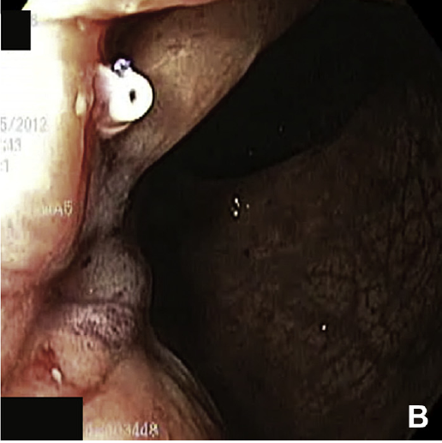
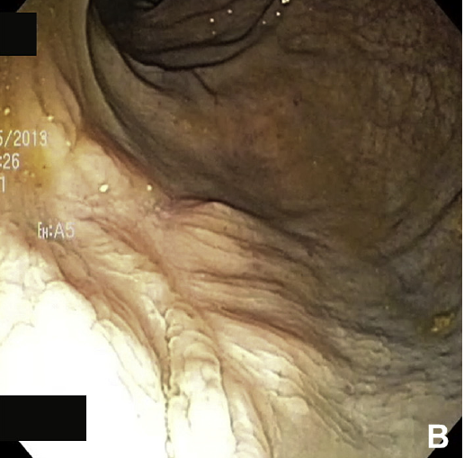
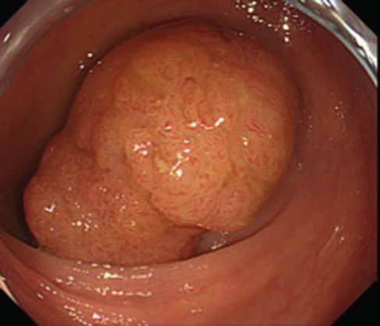
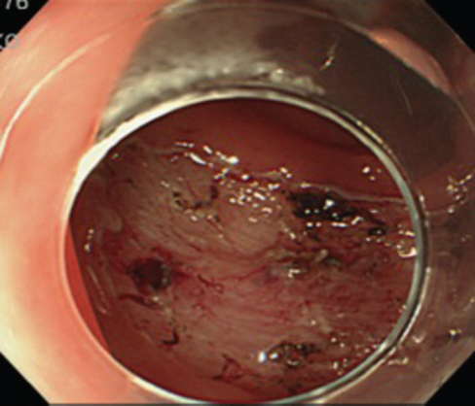
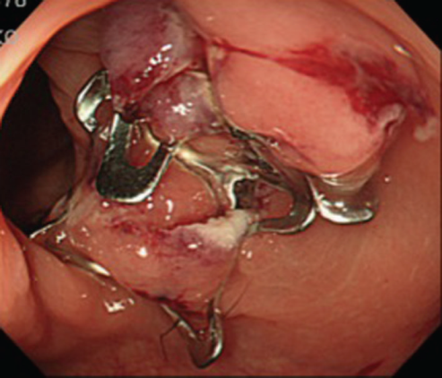
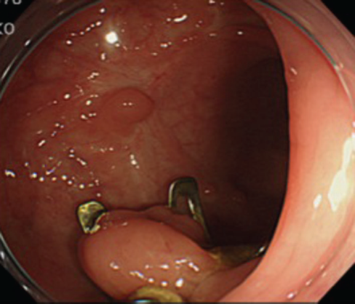
ESD should be performed only in a setting where early and delayed complications can be managed adequately
Closure of dissection defect by Overstich suturing device
Repair of post-resection wall defect with OVESCO

Slide 31
Current methods of endoscopy skill acquisition
Endoscopic simulators:
- inanimate static models or mechanical simulators
computer-generated (virtual reality) models
ex vivo (explanted organ) animal models
in vivo (live) animal models
- hybrid simulations (attaching a simulator to a
simulated patient)
A 2014 ASGE survey revealed that less than half of adult gastroenterology programs in the United States use simulation, and it is mandated in only 15% of programs

Slide 33
Current methods of endoscopy skill acquisition
The use of virtual reality endoscopy simulation training for novice endoscopists aimed at developing basic endoscopic skills can improve subsequent clinical performance
A simulation curriculum that incorporates mentored training and instructional feedback has been shown to provide a distinct advantage compared with self-regulated learning in the acquisition of endoscopic skills
Randomized controlled trials have indicated measurable transfer of skills to the clinical environment and possible potential benefit in shortening the learning curve to competency in some circumstances such as in the early part of training
A reduction in the learning curve of more than 25%, as proposed in the ASGE PIVI document as a threshold for widespread adoption of their use, has yet to be demonstrated

Slide 34
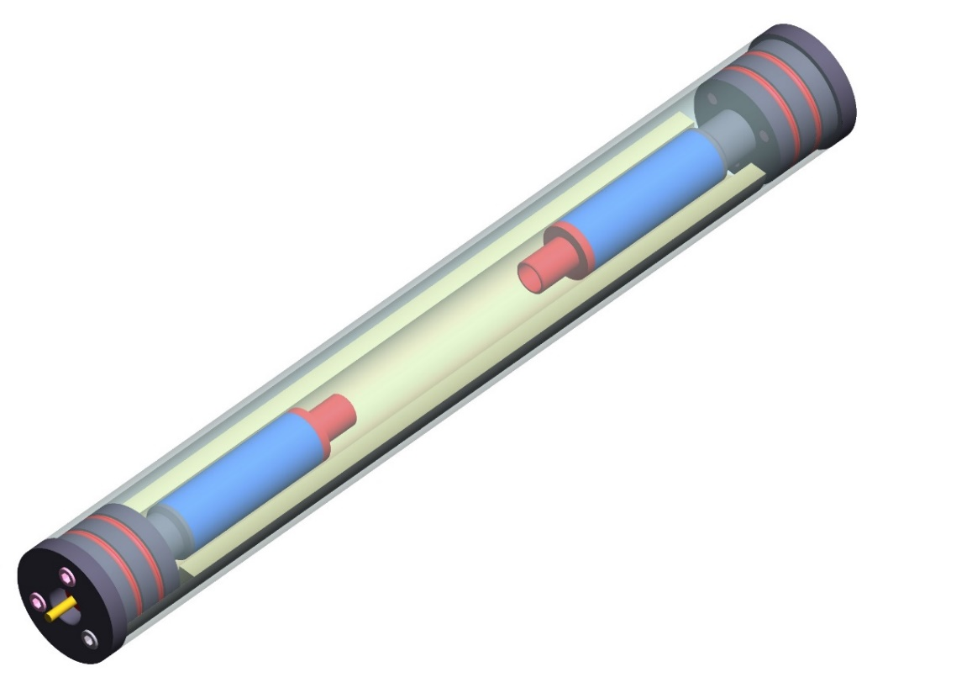
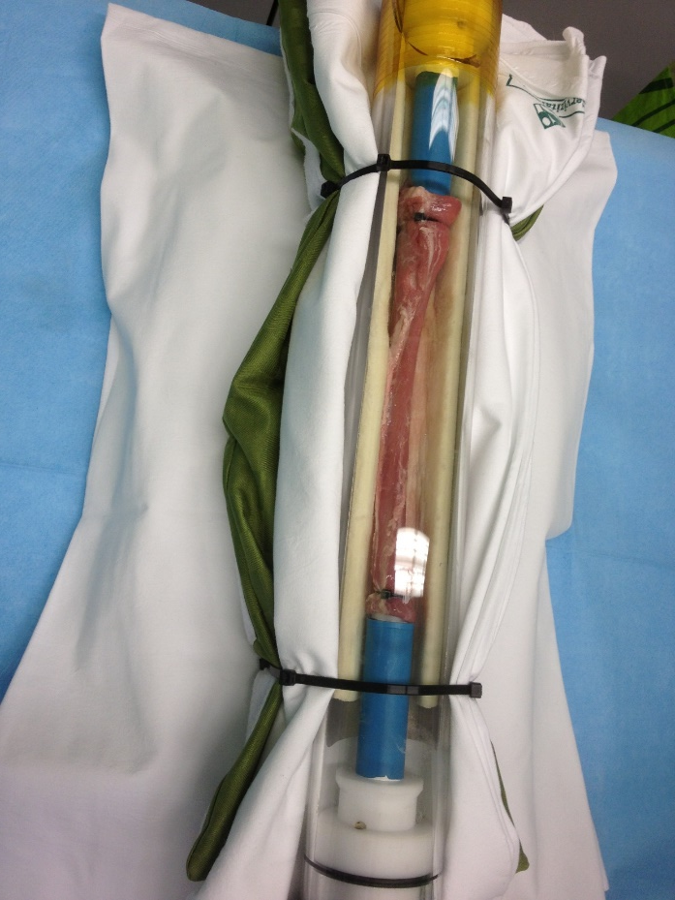
Ex-vivo porcine model for POEM training at HSR: “POMOD”
Azzolini F et al, Surg Endosc submitted

Slide 35
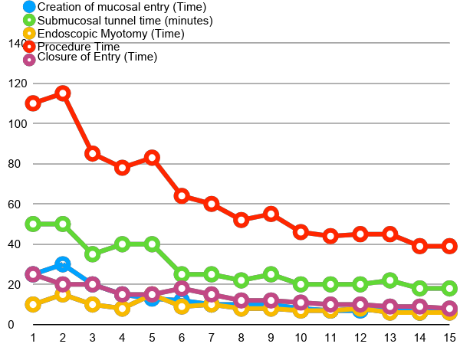
Learning curve for POEM by “POMOD” – 15 procedures

Slide 36
Learning curve to achieve competency in ERCP
Recent performance measures suggest a ≥ 90% selective cannulation rate is an appropriate metric for a native ampulla, but a “competent” ERCP operator should attain a ≥ 95% rate (with precut maneuvers)
1996
Minimal threshold of 100 ERCPs, with a > 85% biliary cannulation rate
2002
Minimal threshold of 180-200 ERCPs, including 120 gallstone extractions, and 60 stent deployments. ASGE Standards of Practice Committee
2007
Minimal threshold of 350 ERCPs performed on a native papilla. Mayo Clinic
2015
Minimal threshold ranges from 79 to 300 ERCPs .

Slide 37
Learning curve to achieve competency in ERCP
Joint Advisory Group (JAG)
British Society of Gastroenterology (BSG) Endoscopy Committee
Knowledge
  To include working clinical knowledge of the underlying diseases, the clinical indications for ERCP and the contra-indications to ERCP.
  Knowledge of safe sedation and informed consent.
  Full knowledge of the guidelines for managing specific risks e.g. antibiotics, anticoagulation etc and identifying high risk patients.
  Passing a knowledge assessment e.g the endoscopic section of the “MRCP Gastro” exit examination

Slide 38
Learning curve to achieve competency in ERCP
Joint Advisory Group (JAG)
British Society of Gastroenterology (BSG) Endoscopy Committee
Skills
  > 80% successful completion of the intended procedure of Level 1 difficulty. This will likely require the performance of a minimum of 200 procedures
  Post-ERCP complication rate of < 5%
  Assessment of skills will be by:
  - records of at least 100 cases during training
  - summative DOPS assessment as per JAG criteria
  - evidence of continued practice with mentoring and recording
  of subsequent 100 cases post summative DOPS
Grade I difficulty for ERCP
Deep cannulation of CBD or main pancreatic duct
Extraction of small-to-medium (≤ 10 mm) biliary stones
Biliary stenting for leaks and drainage

Slide 39
Criteria for training ERCP endoscopists to act as trainers
Joint Advisory Group (JAG)
British Society of Gastroenterology (BSG) Endoscopy Committee
Personal experience of and participation in an average of 75 procedures per year as per non-trainers
Continuous audit certifying complication rates of < 5%; > 90% completion of intended therapy on level 1 patients.
Attendance as Faculty or Observer at ERCP Training Events outside their own network as a minimum once every 5 years.
Working in a network with a workload averaging over 150 procedures per year in order to provide sufficient breadth of experience for trainees.

Slide 40
Joint Advisory Group (JAG)
British Society of Gastroenterology (BSG) Endoscopy Committee
ERCP
Quality
Safety
An agreed minimum workload (procedure type/volume) per endoscopist
A minimum of 2 ERCP-trained endoscopists within a centre or local network, to enable continuous service provision
For each case, a minimum of 3 endoscopy assistants with appropriate competences
Staffing
>90% of ERCPs intended as therapeutic
Completion of the intended therapeutic procedure at initial ERCP in at least 80% of cases
Sphincterotomy bleeding requiring transfusion < 2%
Perforation rate <2%
Clinically symptomatic pancreatitis < 5%
Procedure related mortality <1%
Quality standards

Slide 41
Endoscopy 2018; 50: 1116–1127
Domains and performance measures chosen by the ESGE pancreatobiliary working group

Slide 42
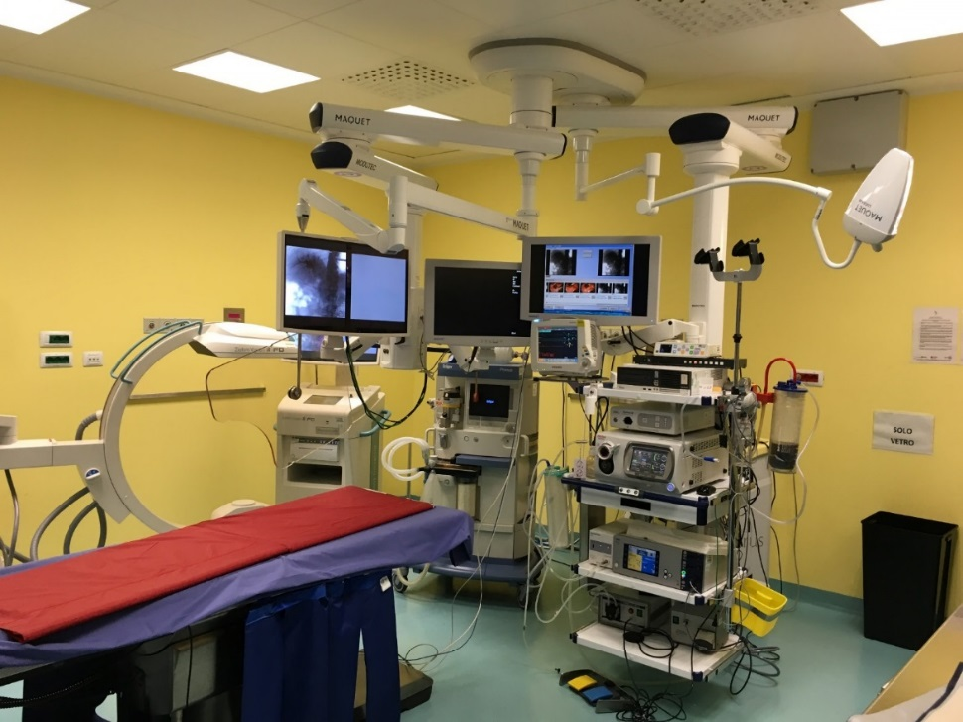
Endoscopy 2018; 50: 1186–1204
Endoscopy room = operatory room 2nd – 3rd level structures
Adequate instrumentation - X-ray support - EUS support - CO 2 availability - devices specific for procedures
Anaesthesiologist assistance - deep sedation - general anaesthesia
Adequate nurse assistance

Slide 43
Endoscopy 2018; 50: 1186–1204

Slide 44
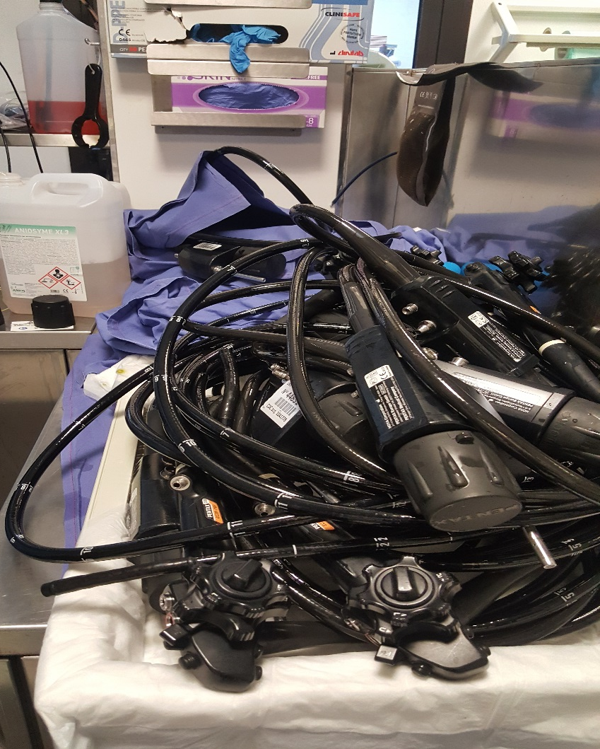
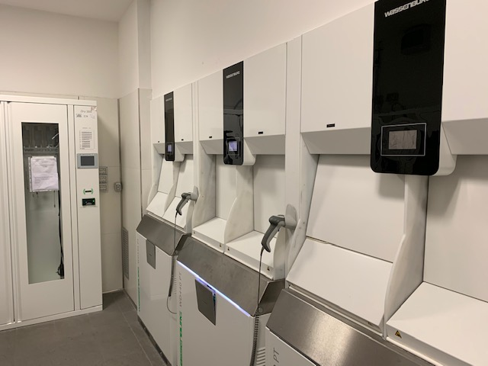

Slide 45
Endoscopy 2018; 50: 1205–1234
The documentation of the reprocessing procedure should include:
▪ The patient on whom the endoscope was last used;
▪ The endoscope identification;
▪ The whole reprocessing cycle including all manual cleaning steps, and
identification of the EWD/ADD and storage cabinet used;
▪ The time-frame for reprocessing and storage;
▪ Identification of the staff member involved in reprocessing of that
endoscope;
▪ Identification of the staff who check the correct performance of the
reprocessing cycle and release the endoscope for use on the next
patient.

Slide 46
Endoscopy 2018; 50: 1205–1234

Slide 47
How to prevent and manage complications of endoscopy ?
Please, don’t forget
appropiateness
adherence to guidelines
patient information

